Slide 1


Slide 2
Developing steps
Proof of concept
Get all softwares ready
Business model
finishing

Slide 3
Developing steps
Proof of concept
Get all softwares ready
Business model
finishing

Slide 4
Pain point
Traffic jam , short distance , wasting boring time in transportation , sometime it's costed .

Slide 5
Bsklta
Bsklta will address the need for funny ,enjoyable , and a new way of the cheapest transportation . It will shift from four wheels to two wheels. ,It’s a bike sharing network where users grab a ride through mobile application

Slide 6
How Bsklta works?
To hitch a ride , a user opens the app ,uses his or her phone to get the password of bike and then unlock the bike's smart lock and begins the timer on the app . After finishing his or her ride and the locker become closed the timer will be off . The ride cost will deduct from credit . Customer can recharge by credit card

Slide 7
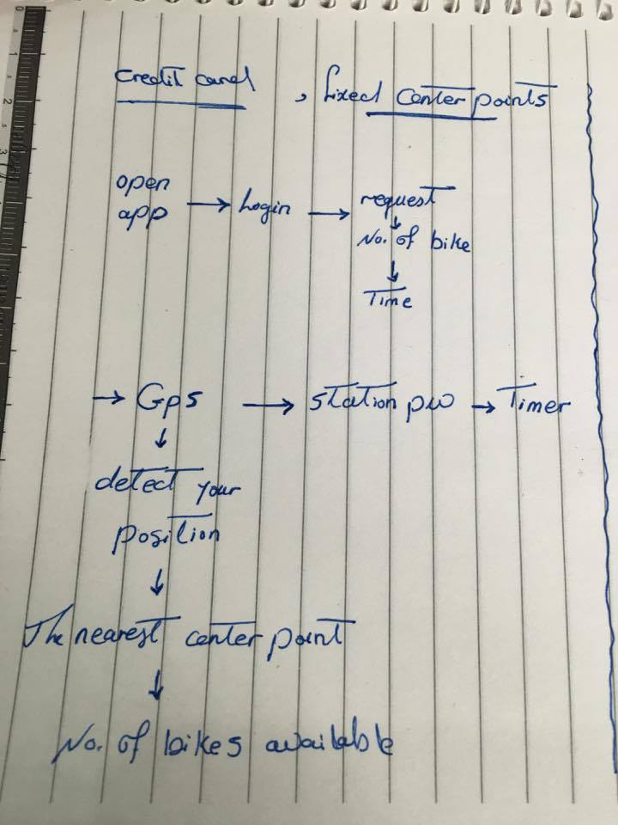
How Bsklta works?
Handwritten

Slide 8
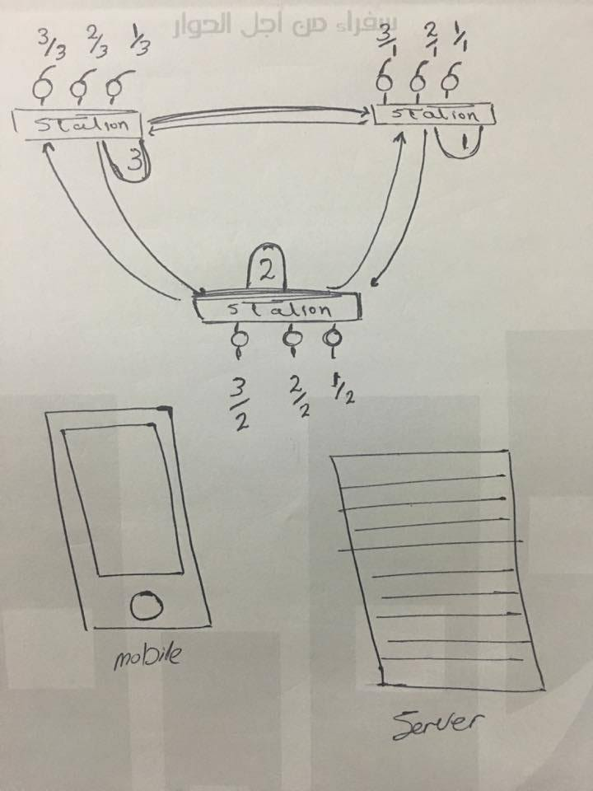
How Bsklta works?
Handwritten

Slide 9
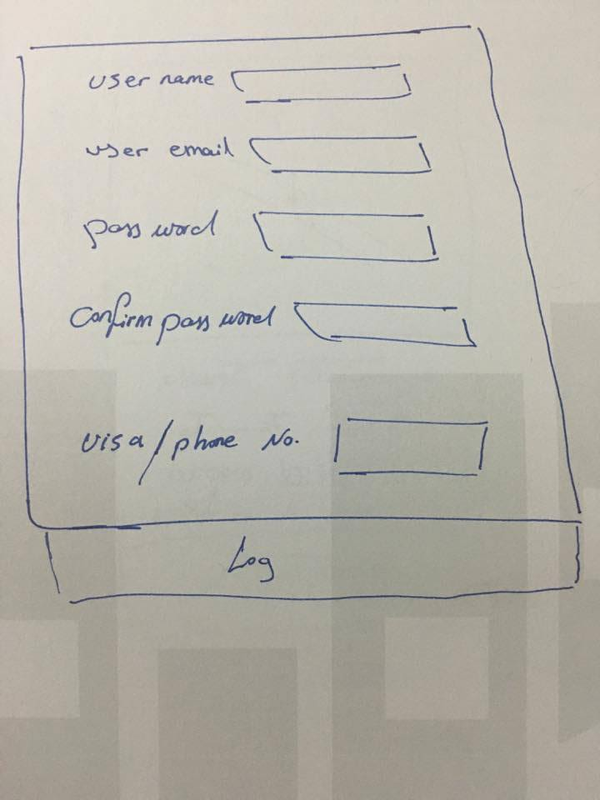
How Bsklta works?
Handwritten

Slide 10
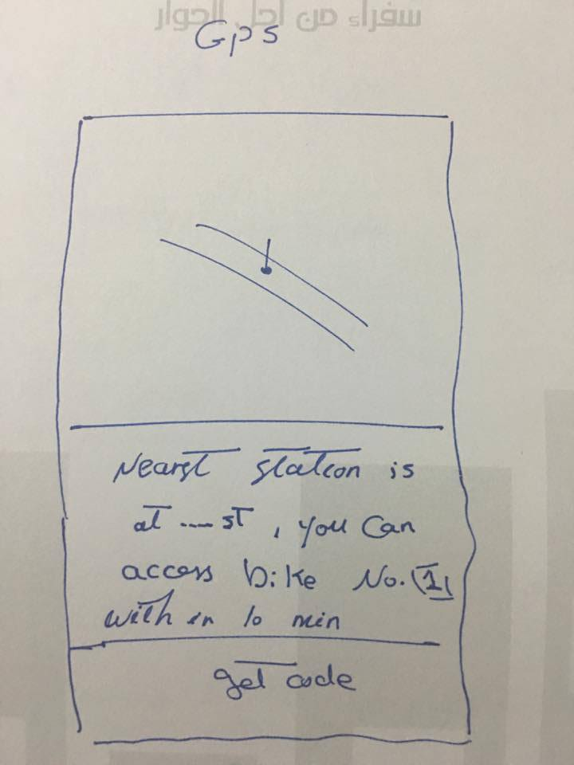
How Bsklta works?
Handwritten

Slide 11
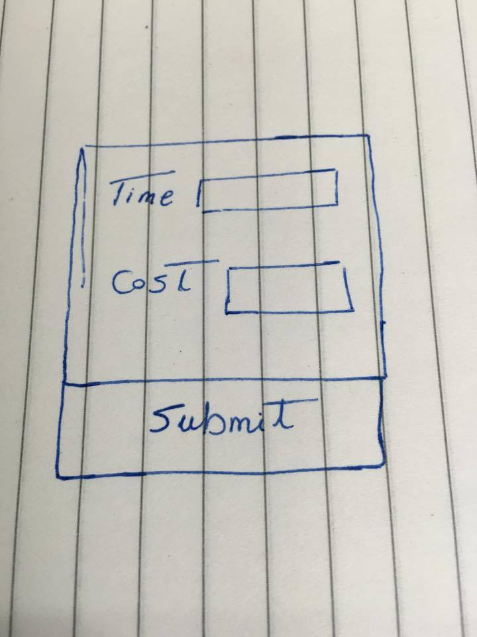
How Bsklta works?
Handwritten

Slide 12
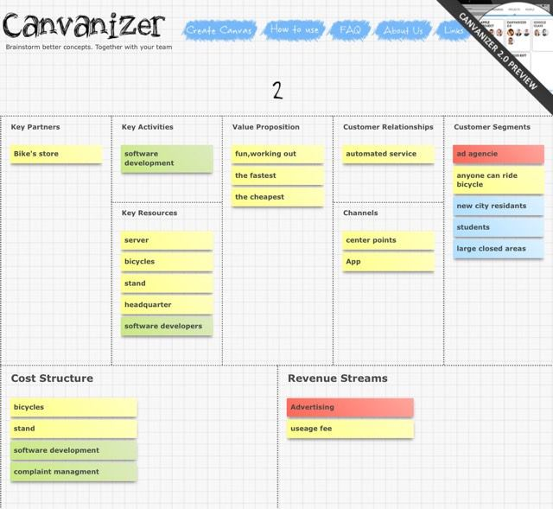
Business Module
canvanizer.com

Slide 13
Developing steps
Proof of concept
Get all softwares ready
Business model
finishing

Slide 14
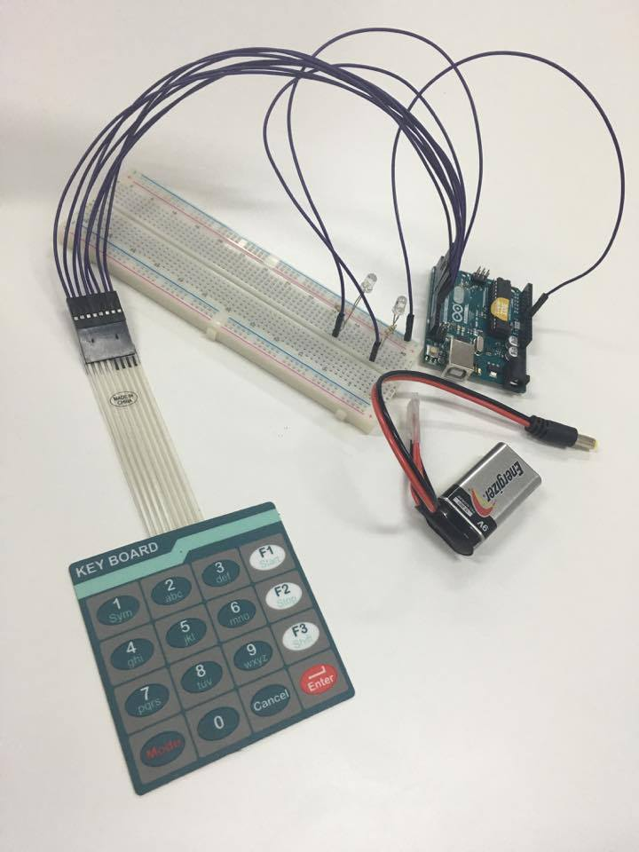
Proof of concept

Slide 15
Hardware
Arduino Uno/Mega x1
Breadboard x1
4×4 Keypad x1
Red LED x1
Green LED x1
220 Ohm x2
Jumper Cable

Slide 16
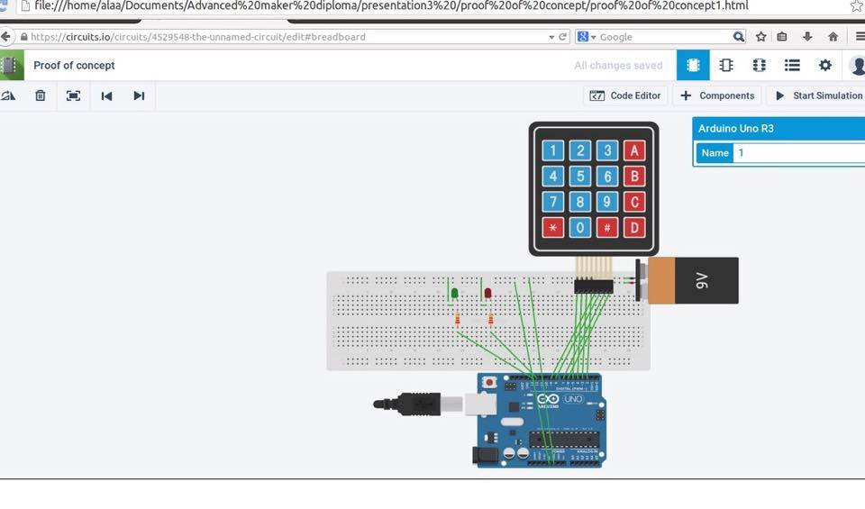
wiring

Slide 17
Video 1

Slide 18
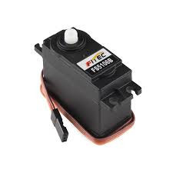
Servo motor
Continuous rotation servo

Slide 19
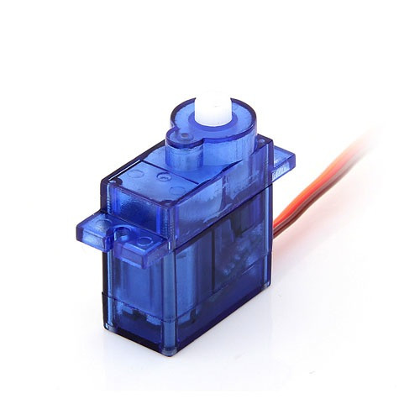
Servo motor
you can position the motor shaft at a specific position (angle) using control signal

Slide 20
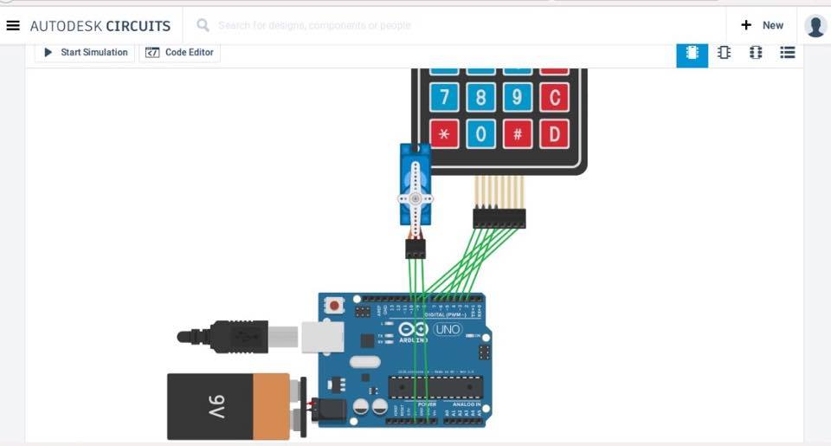
wiring

Slide 21
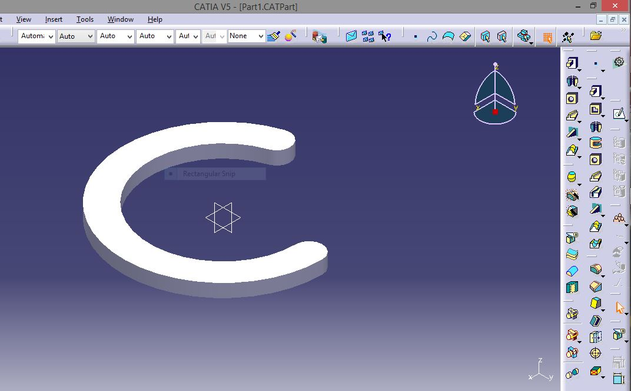
C part
Catia software
Reference: Rania

Slide 22
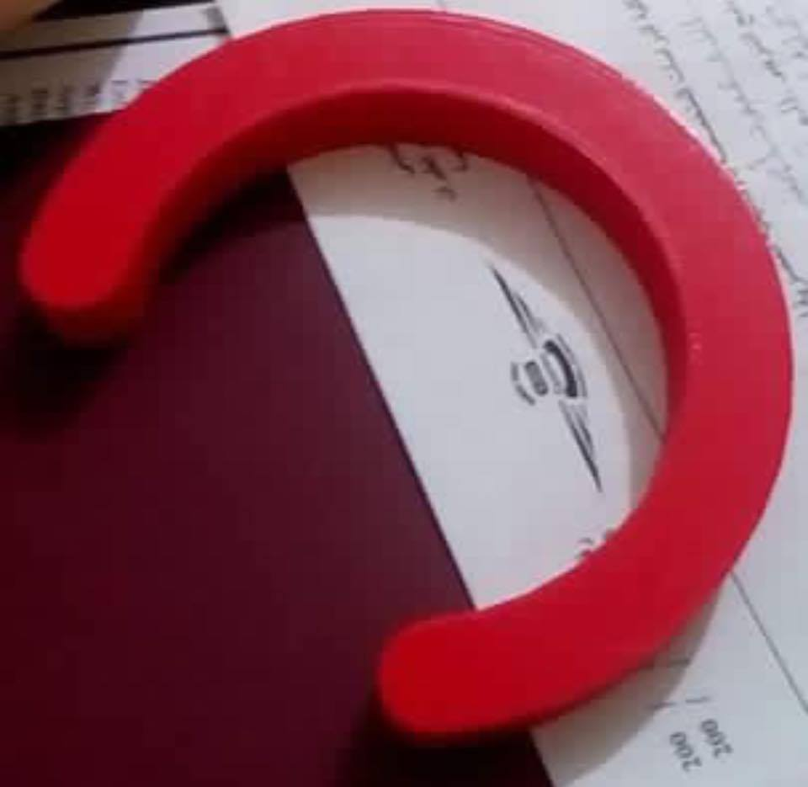
C part
3D printer
Reference: Mina

Slide 23
Video 2

Slide 24
Video 3

Slide 25
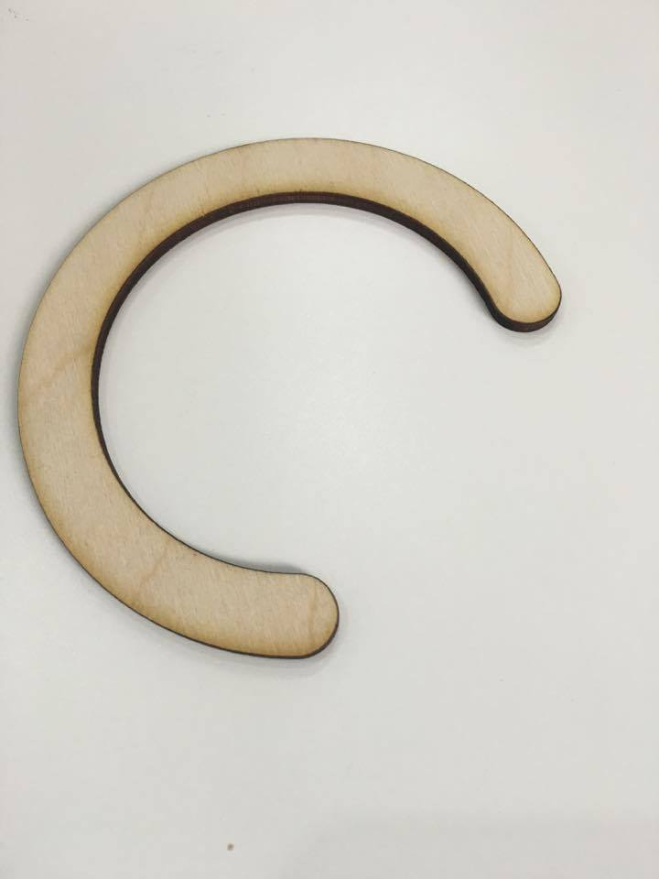
C part
Lazer cutter

Slide 26
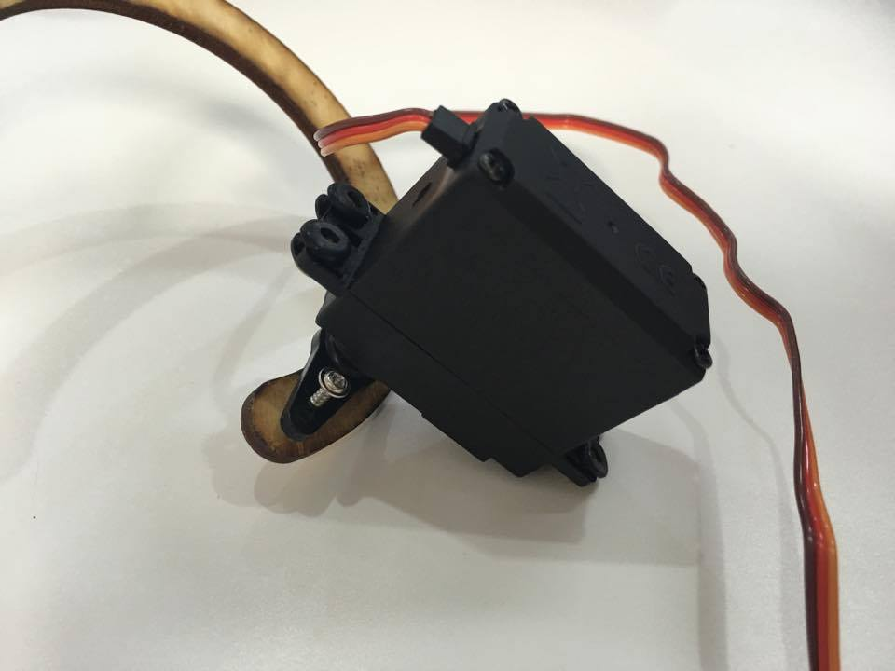
Fixing to servo

Slide 27
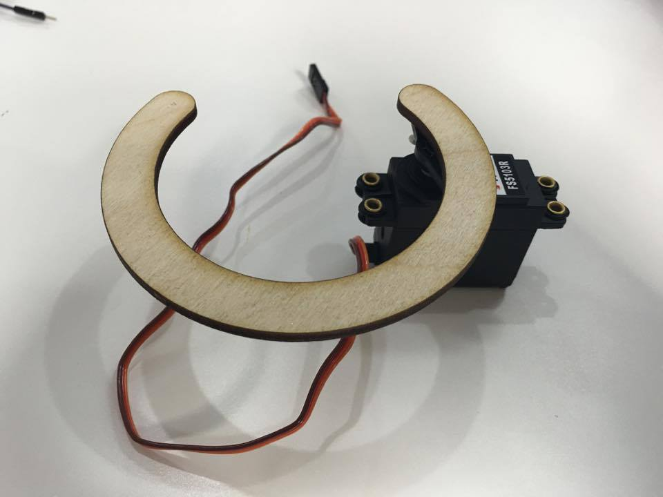
Fixing to servo

Slide 28
Video 4
Reference : Mohamed aksha

Slide 29
Developing steps
Proof of concept
Get all softwares ready
Business model
finishing

Slide 30
Front End
HTML – CSS – JS
Server
Front End
Back End
Software
Arduino
Hardware
Eagle
catia
Front-end is what you see (design, typography, colors, etc).
By typing the code at any text editor (sublime) and saving the file with .html extension for HTML , .css extension for CSS stylesheet and .js for JavaScript files

Slide 31
Back End
Server
Front End
Back End
Software
Arduino
Hardware
Eagle
catia
Python, Django (ubuntu 14.04)
In the terminal :1) pip
2) sudo apt-get install python-pip
3)sudo pip install django
You can test that the installation was successful by typing:
Django-admin –version

Slide 32
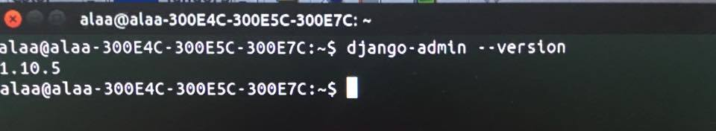
Back End
Server
Front End
Back End
Software
Arduino
Hardware
Eagle
catia

Slide 33
Back End
Server
Front End
Back End
Software
Arduino
Hardware
Eagle
catia
LAMP stack is a group of open source software used to get web servers up and running. The acronym stands for Linux, Apache, MySQL, and PHP.
Installation

Slide 34
Get all software ready
Server
Front End
Back End
Software
Arduino
Hardware
Eagle
catia

Slide 35
Arduino
Server
Front End
Back End
Software
Arduino
Hardware
Eagle
catia
Arduino
Open-source electronic prototyping platform enabling users to create interactive electronic objects.
You can install it directly from software center

Slide 36
Get all software ready
Server
Front End
Back End
Software
Arduino
Hardware
Eagle
catia

Slide 37
Eagle
Server
Front End
Back End
Software
Arduino
Hardware
Eagle
catia
Eagle :CAD software used for PCB designing and schematic
Installing: download suitable version-extract this file – create your account on autodesk

Slide 38
Catia
Server
Front End
Back End
Software
Arduino
Hardware
Eagle
catia

Slide 39
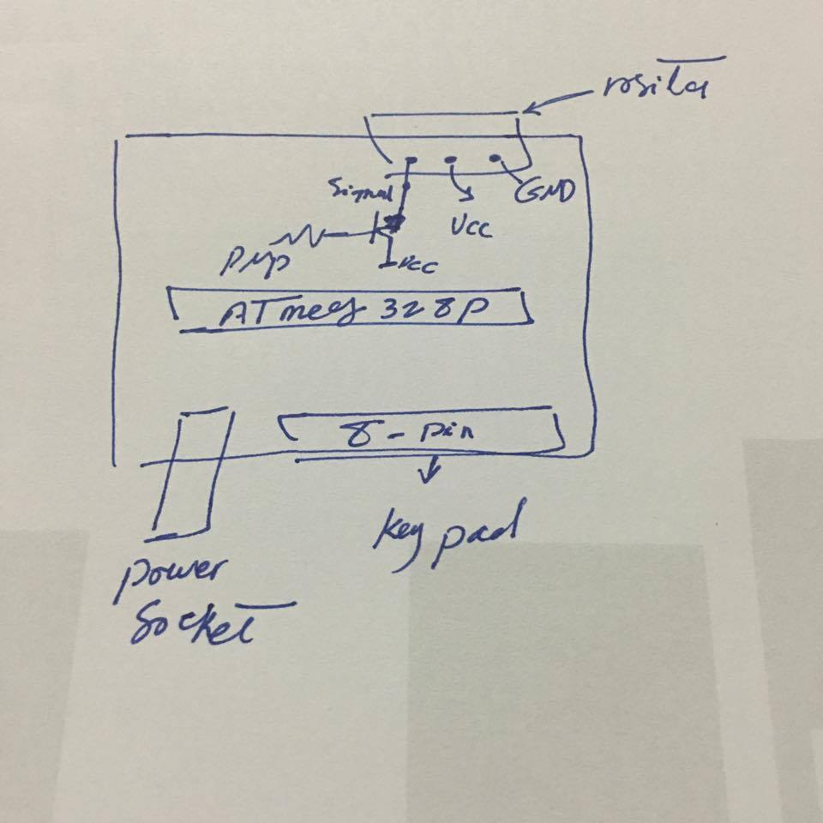
Eagle
Hand drawing
Reference :Islam

Slide 40
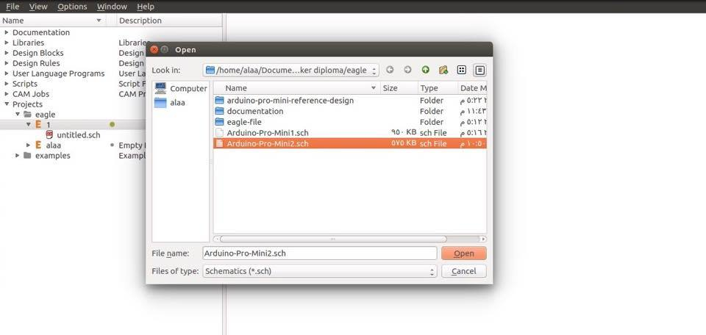
Eagle
open → Schematic.

Slide 41
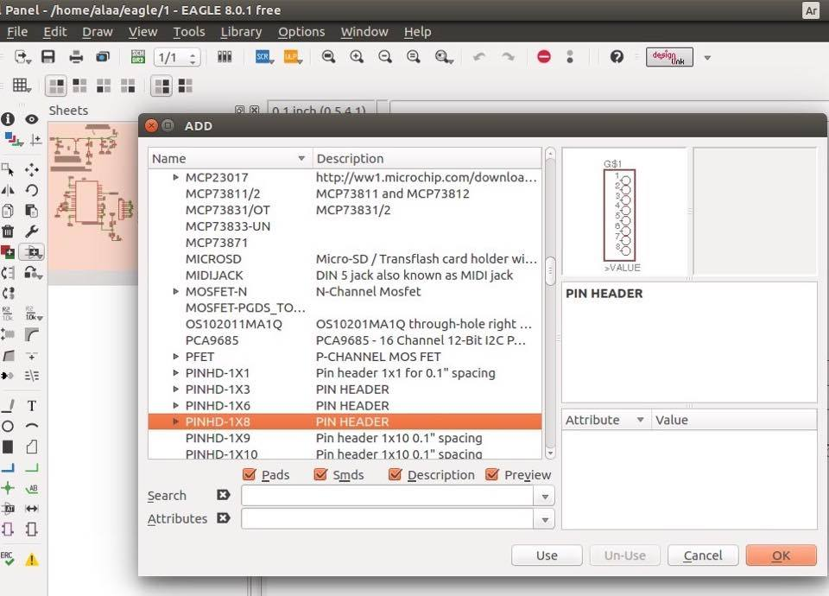
Eagle
add all of the parts we will need
‘Add’ icon on the left-side toolbox

Slide 42
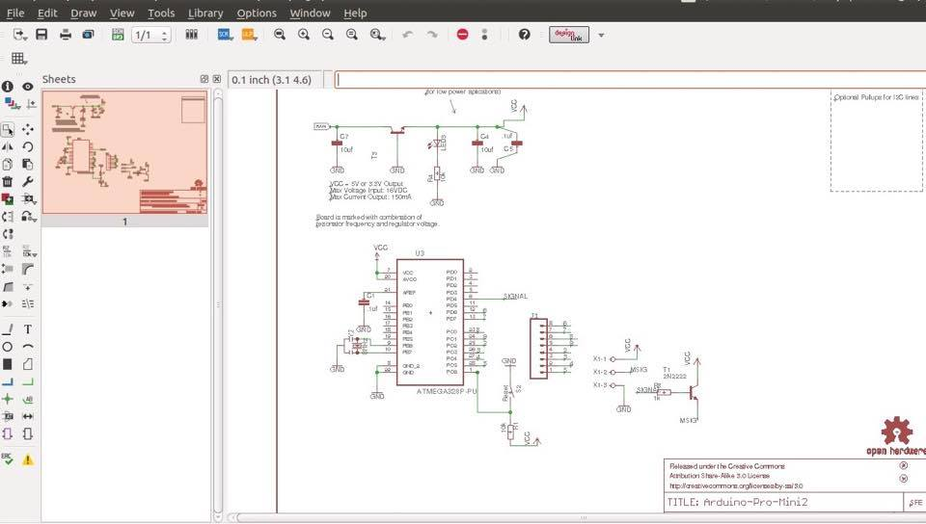
Eagle
for the connectivity! Select the ‘NET’ tool from the toolbox

Slide 43
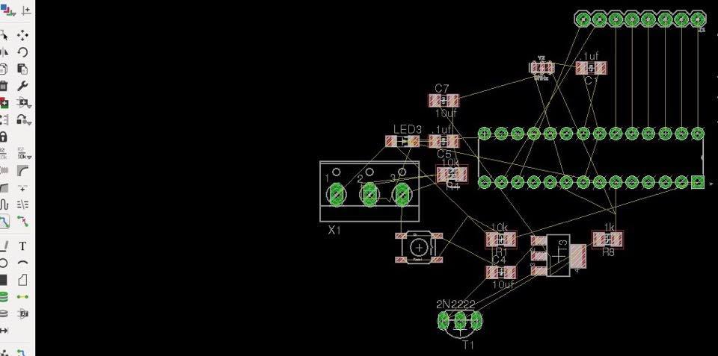
Eagle
File >> switch to board

Slide 44
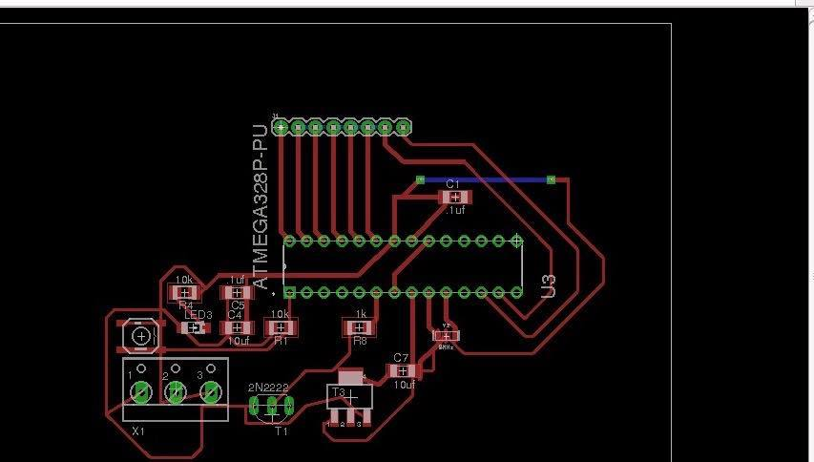
Eagle
position the footprints
Select the ‘Route’ tool
to add the
traces

Slide 45
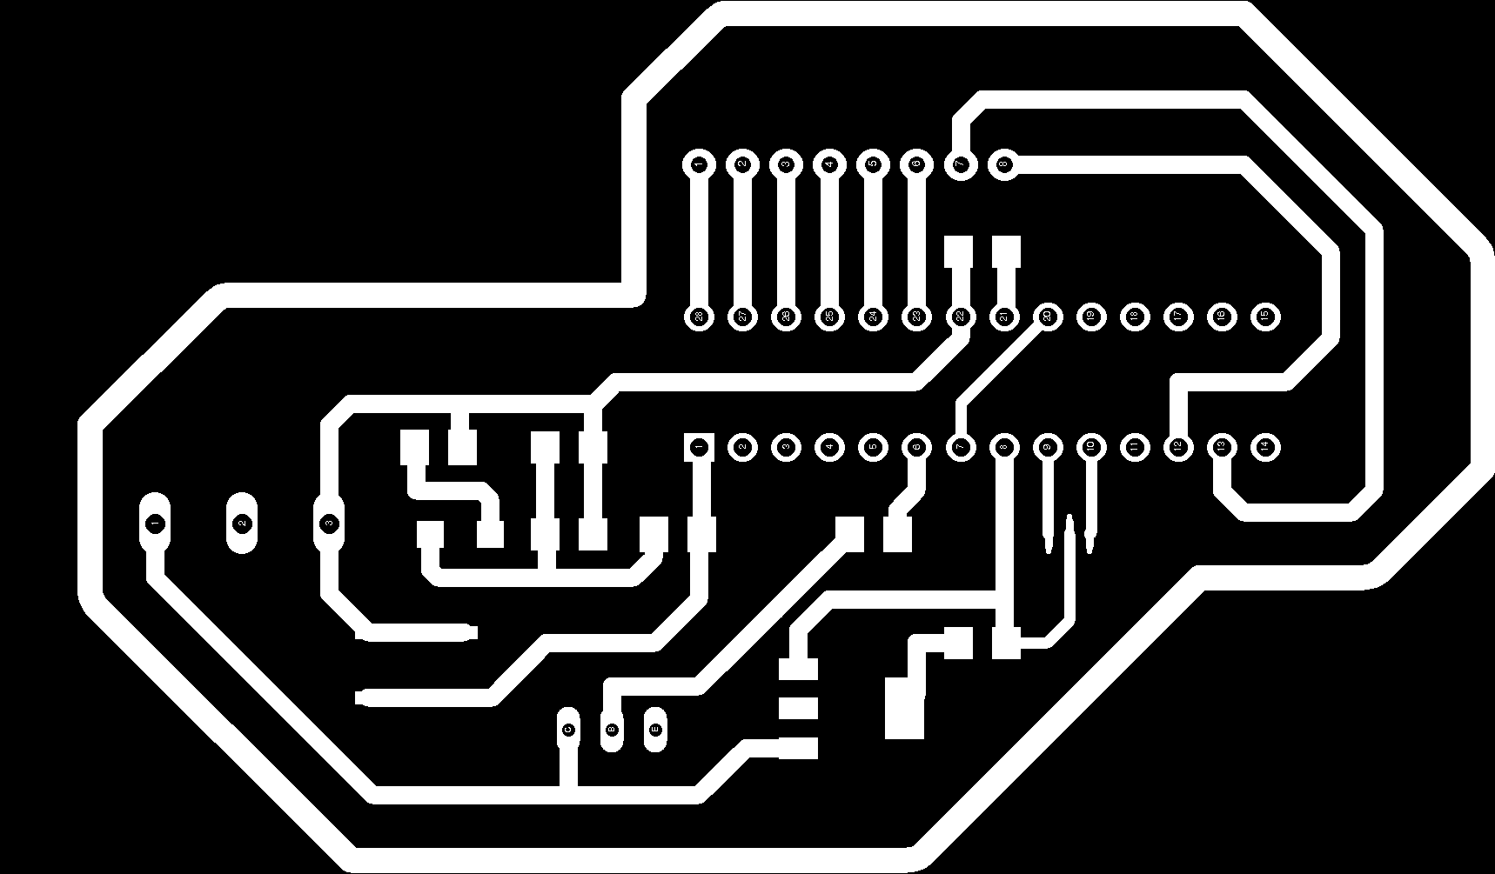
Eagle
Export traces img
Layers: top,pads and dimension

Slide 46
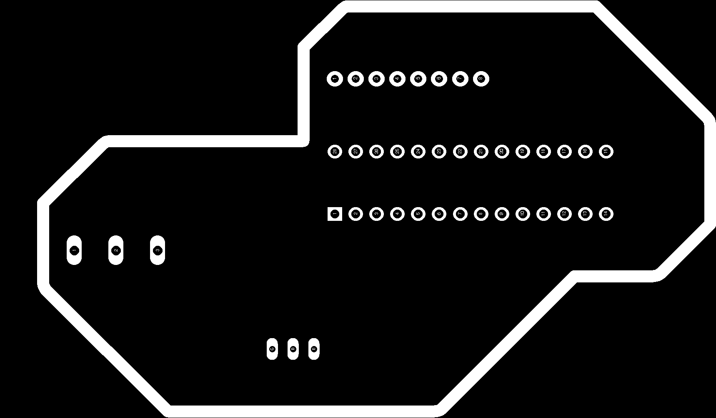
Eagle
Export cut-out img
Layers : dimensions and pads

Slide 47
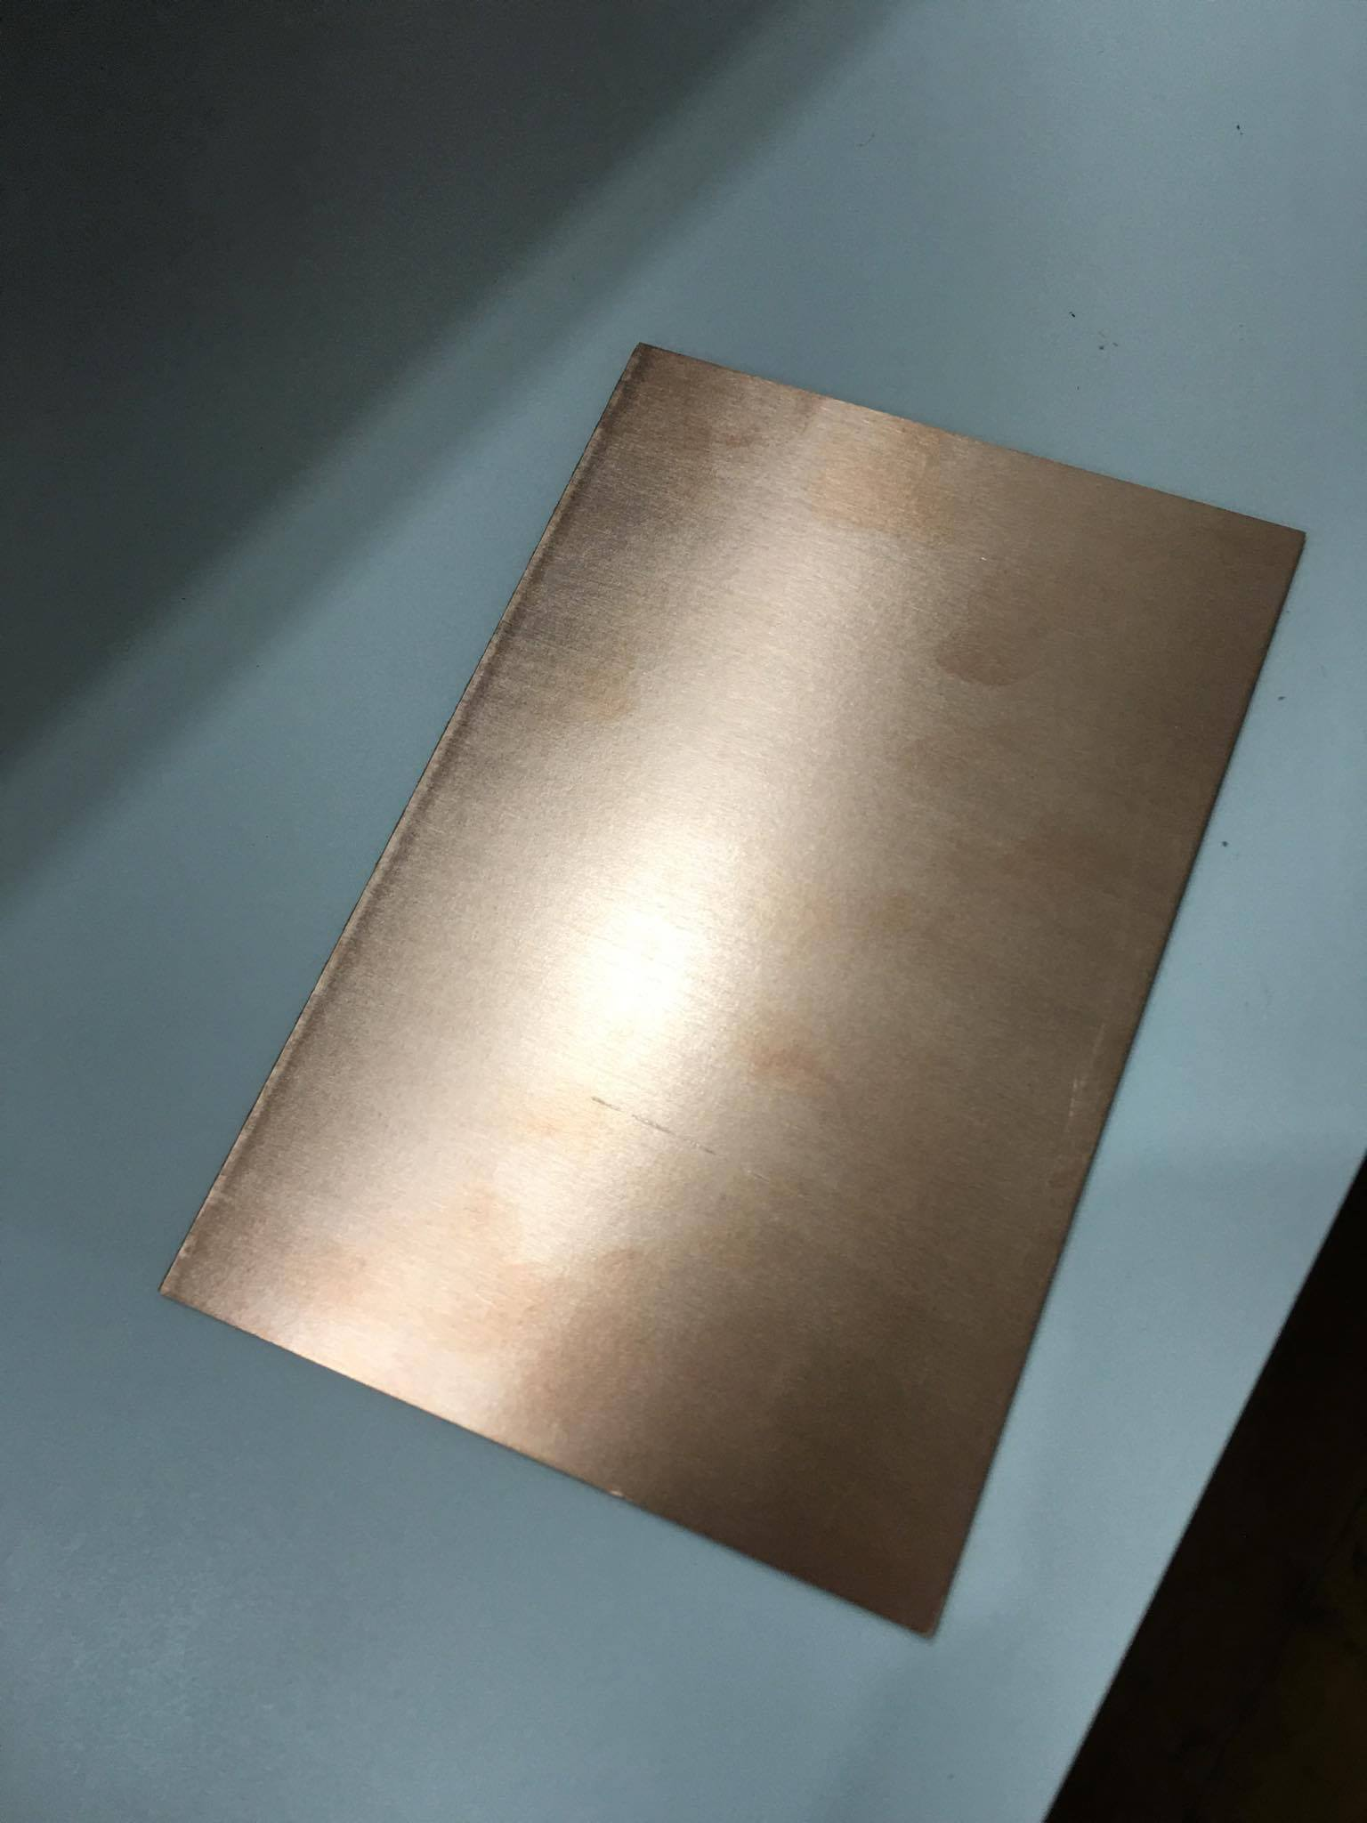
Modela
Copper sheet
FR1
Singel face
15x10
MTM electronics

Slide 48
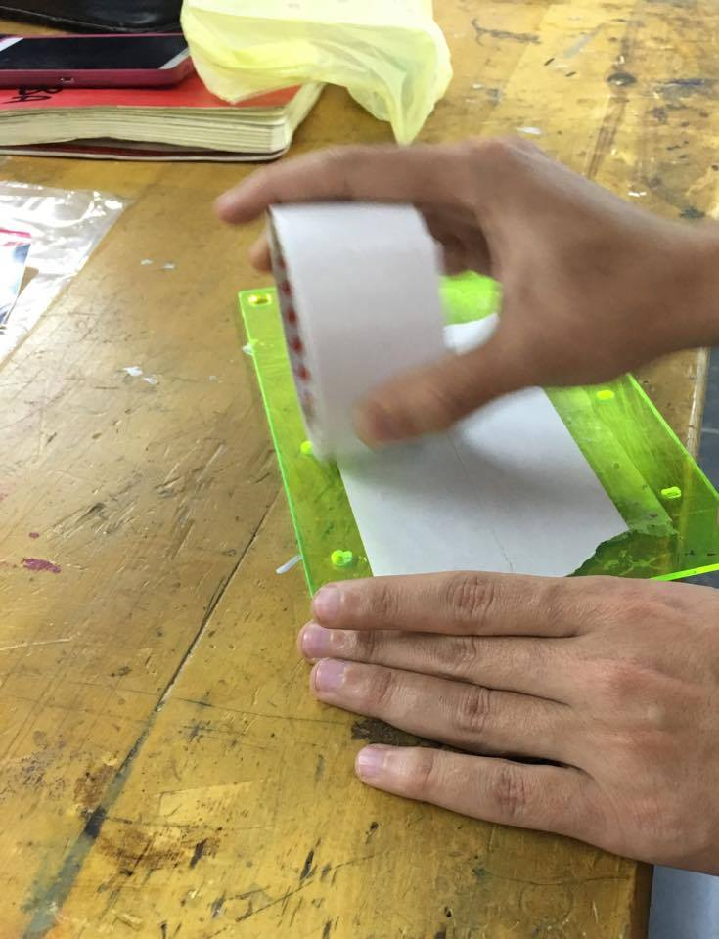
Modela
Reference :Ayman

Slide 49
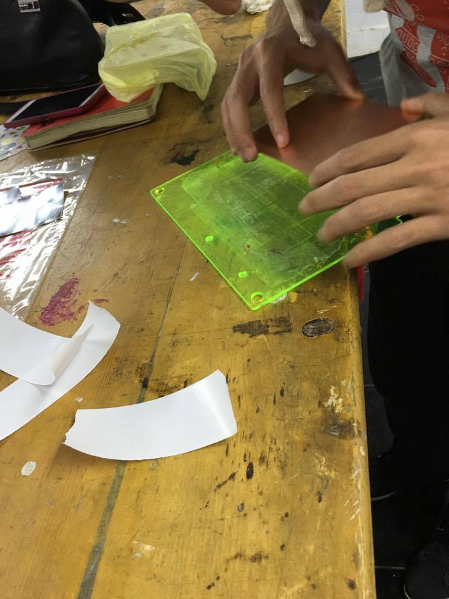
Modela

Slide 50
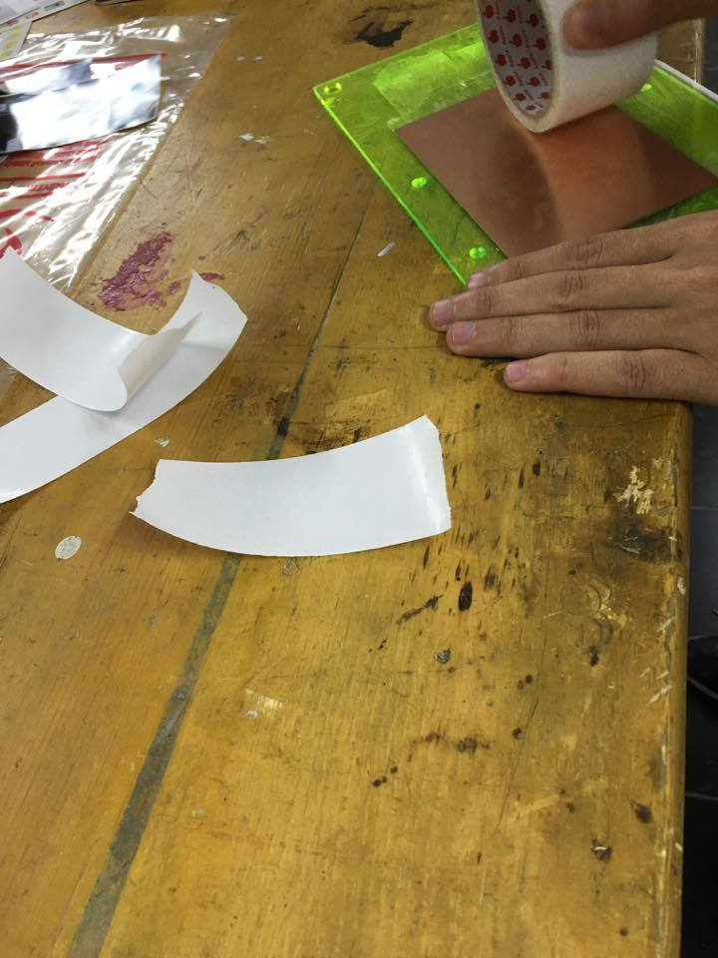
Modela

Slide 51
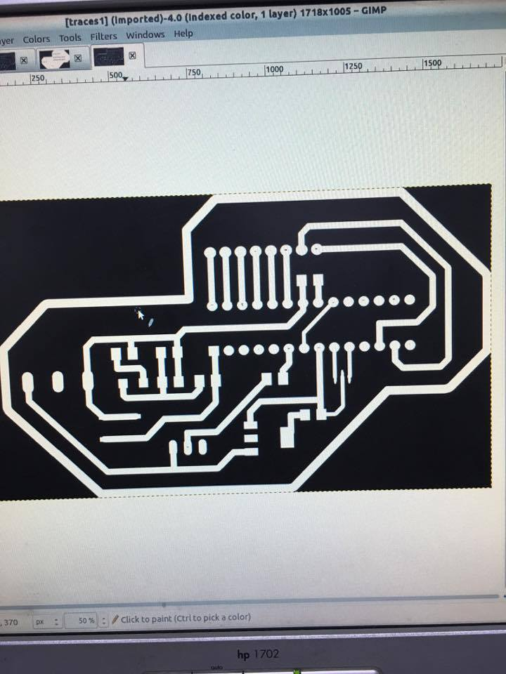
GIMP
Fill pads layer by white color

Slide 52
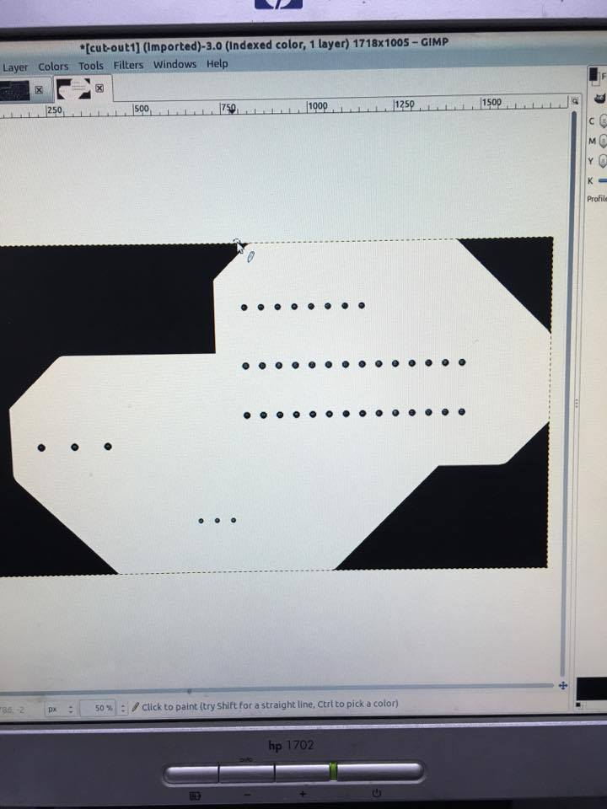
GIMP

Slide 53
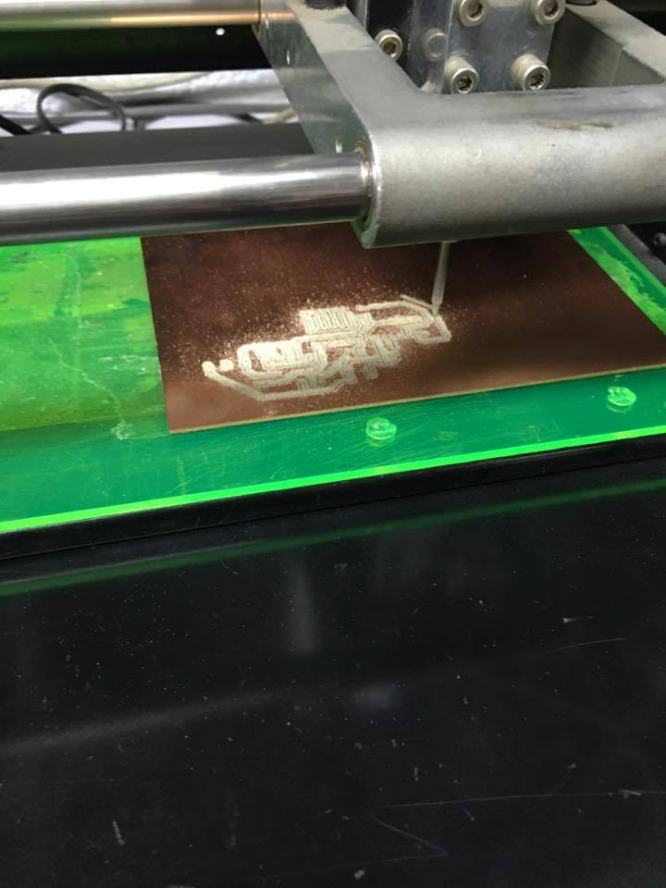
Modela

Slide 54
Modela

Slide 55
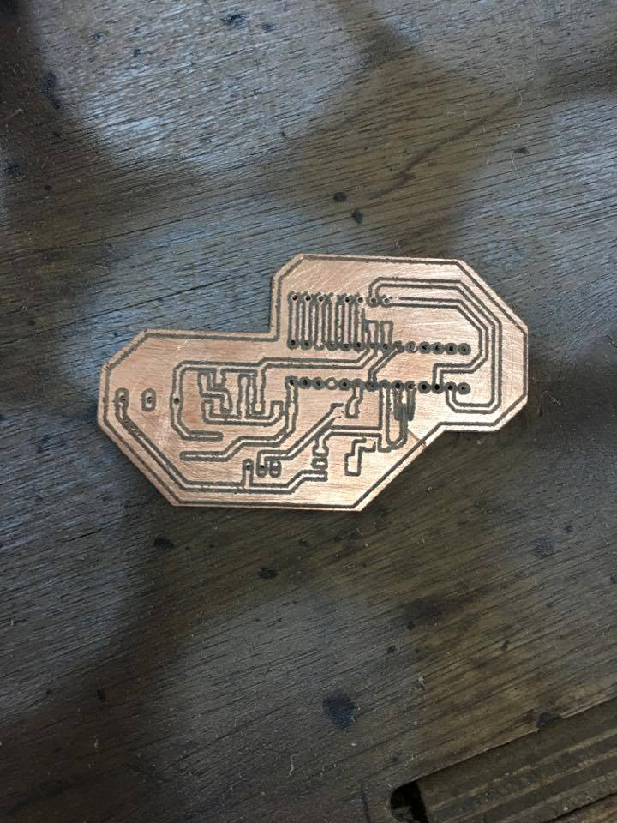
PCB

Slide 56
Developing steps
Proof of concept
Get all softwares ready
Business model
finishing

Slide 57
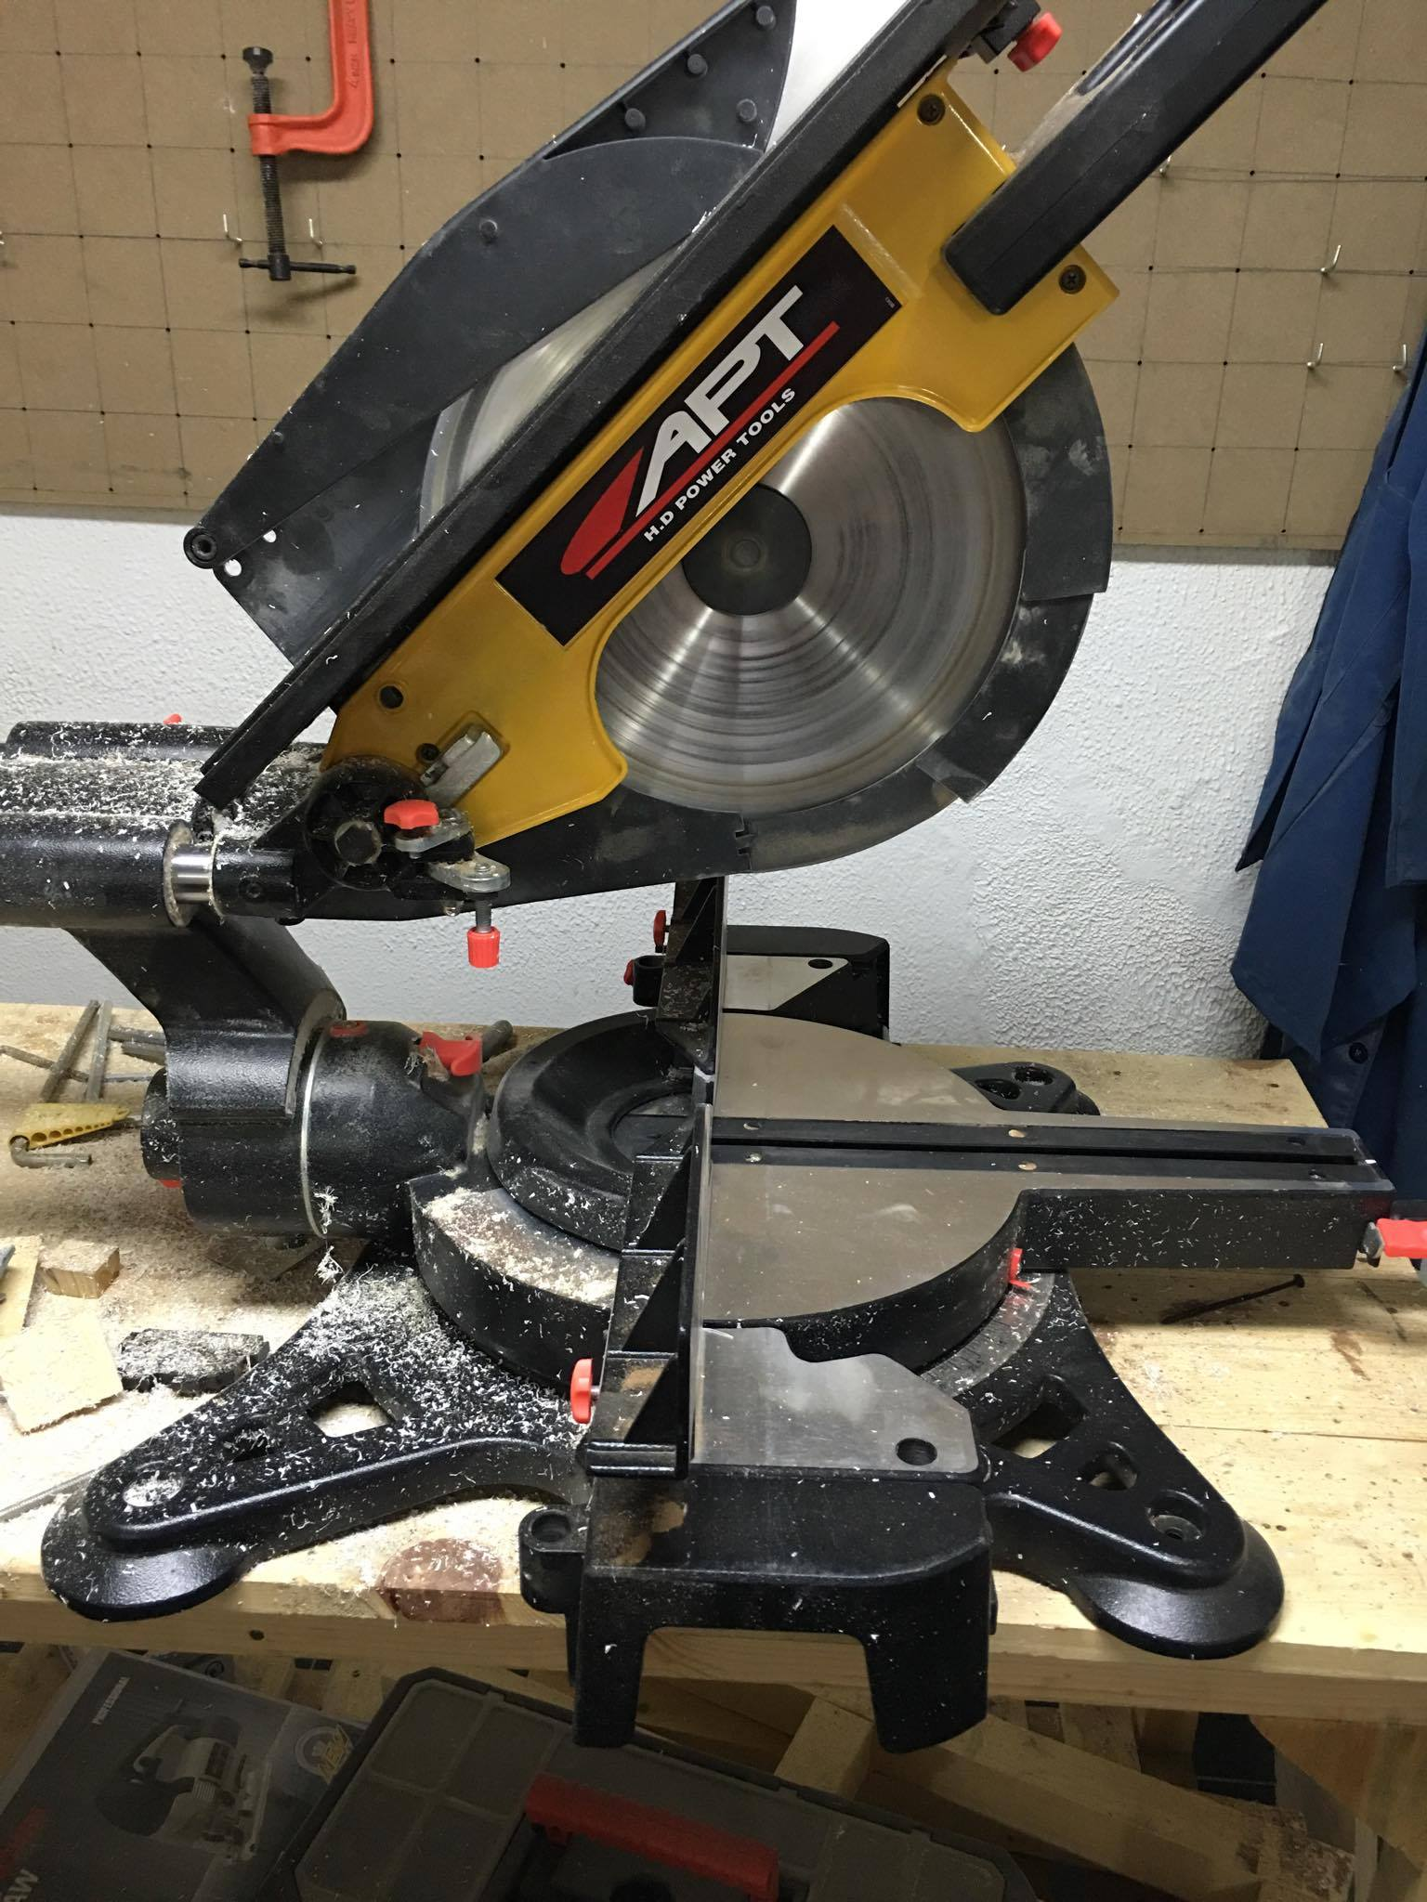
Saw
Reference: Omar

Slide 58
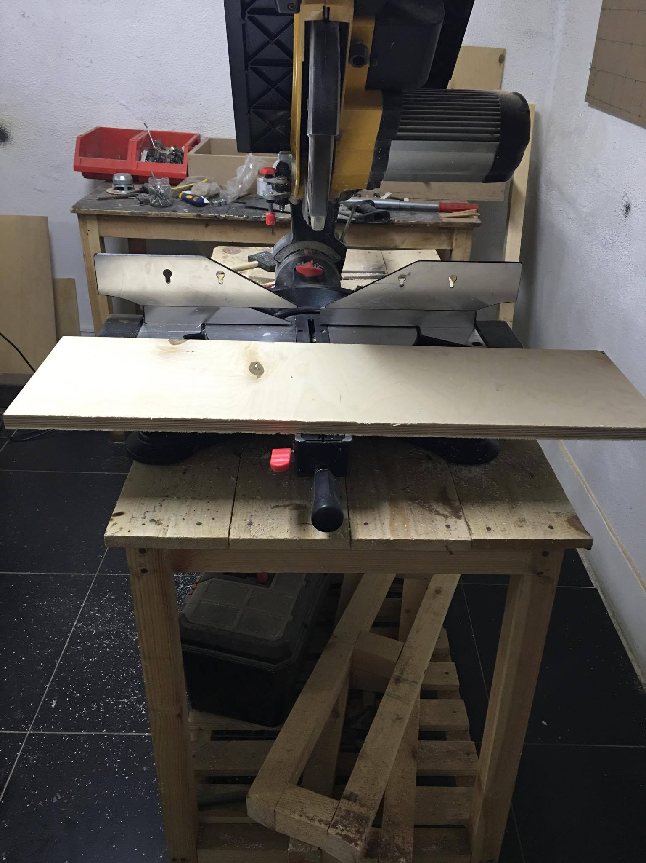
Saw

Slide 59
video5

Slide 60
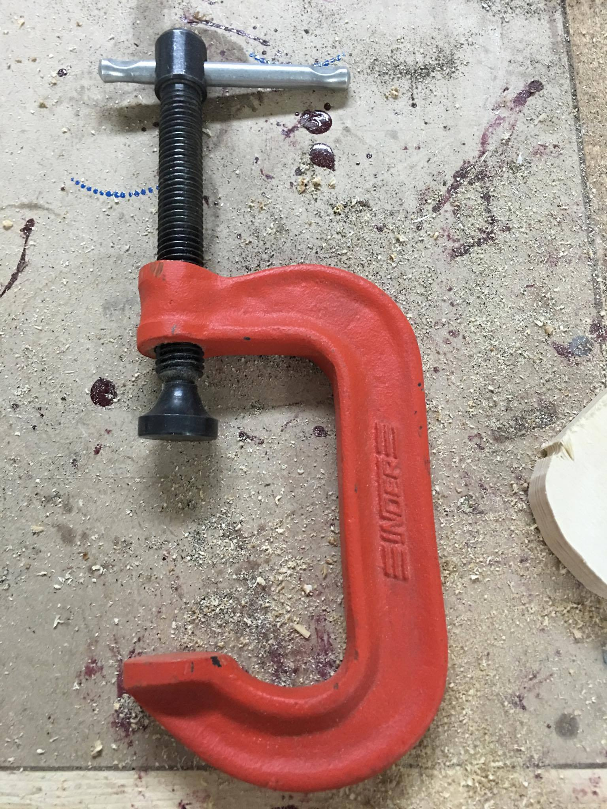

Slide 61
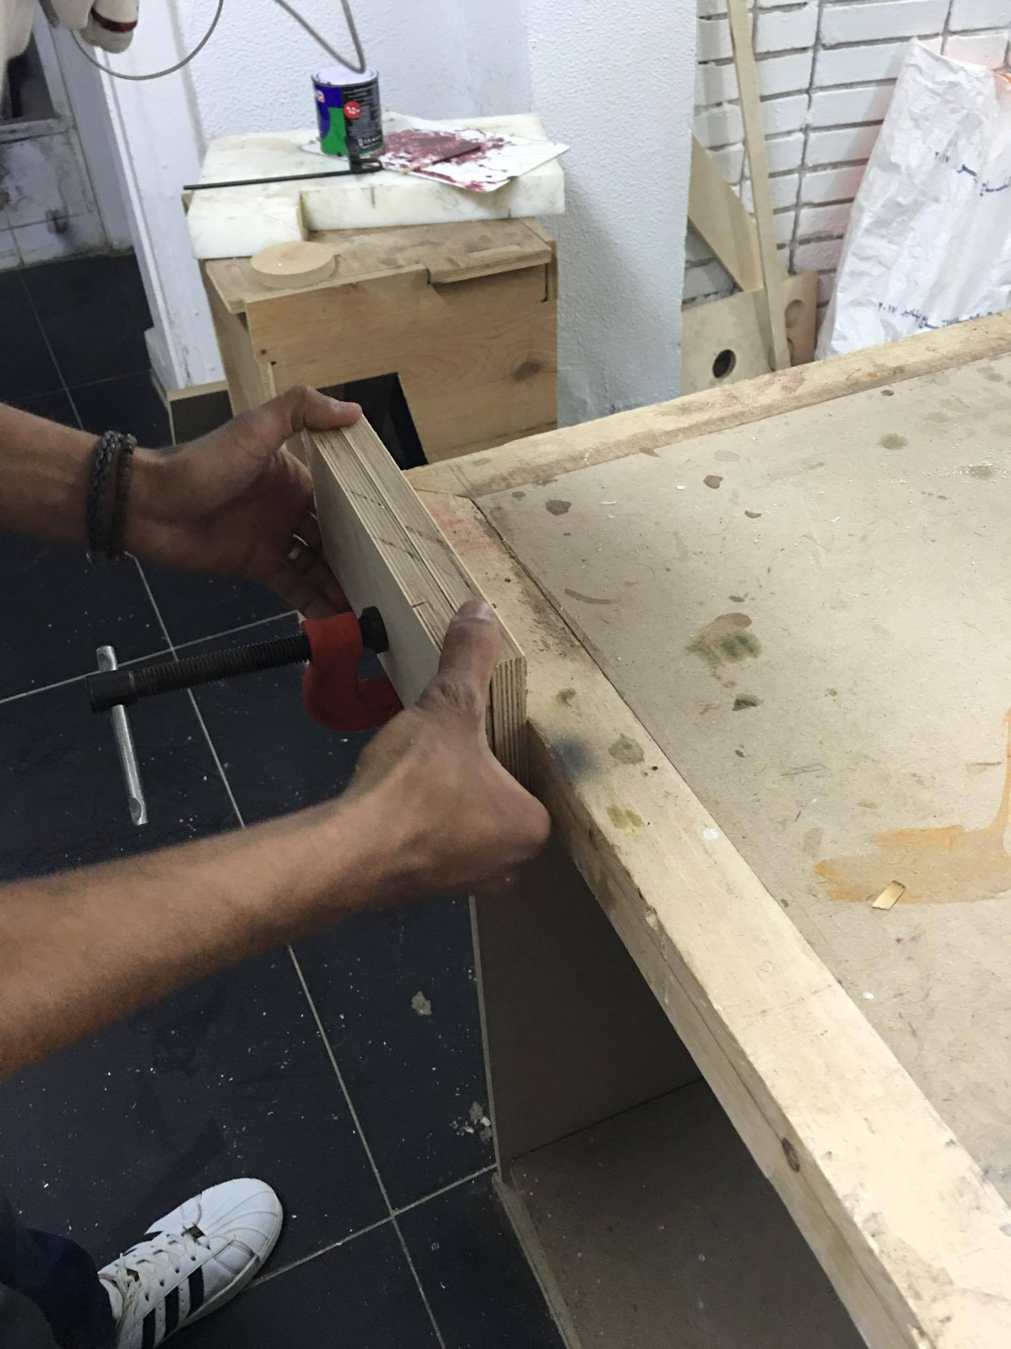

Slide 62
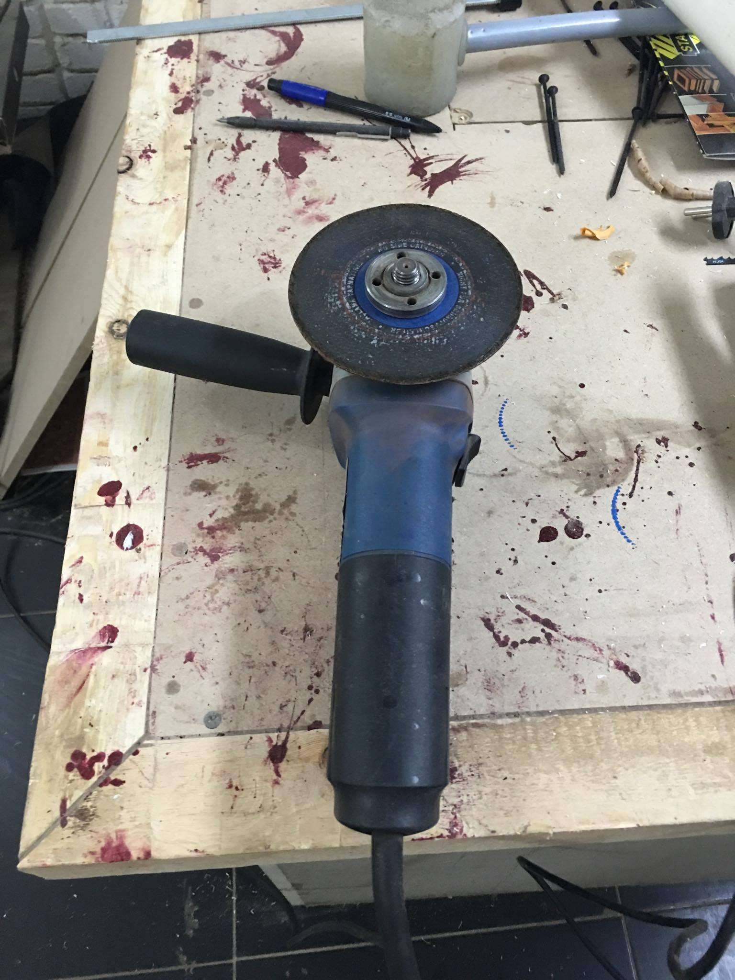

Slide 63
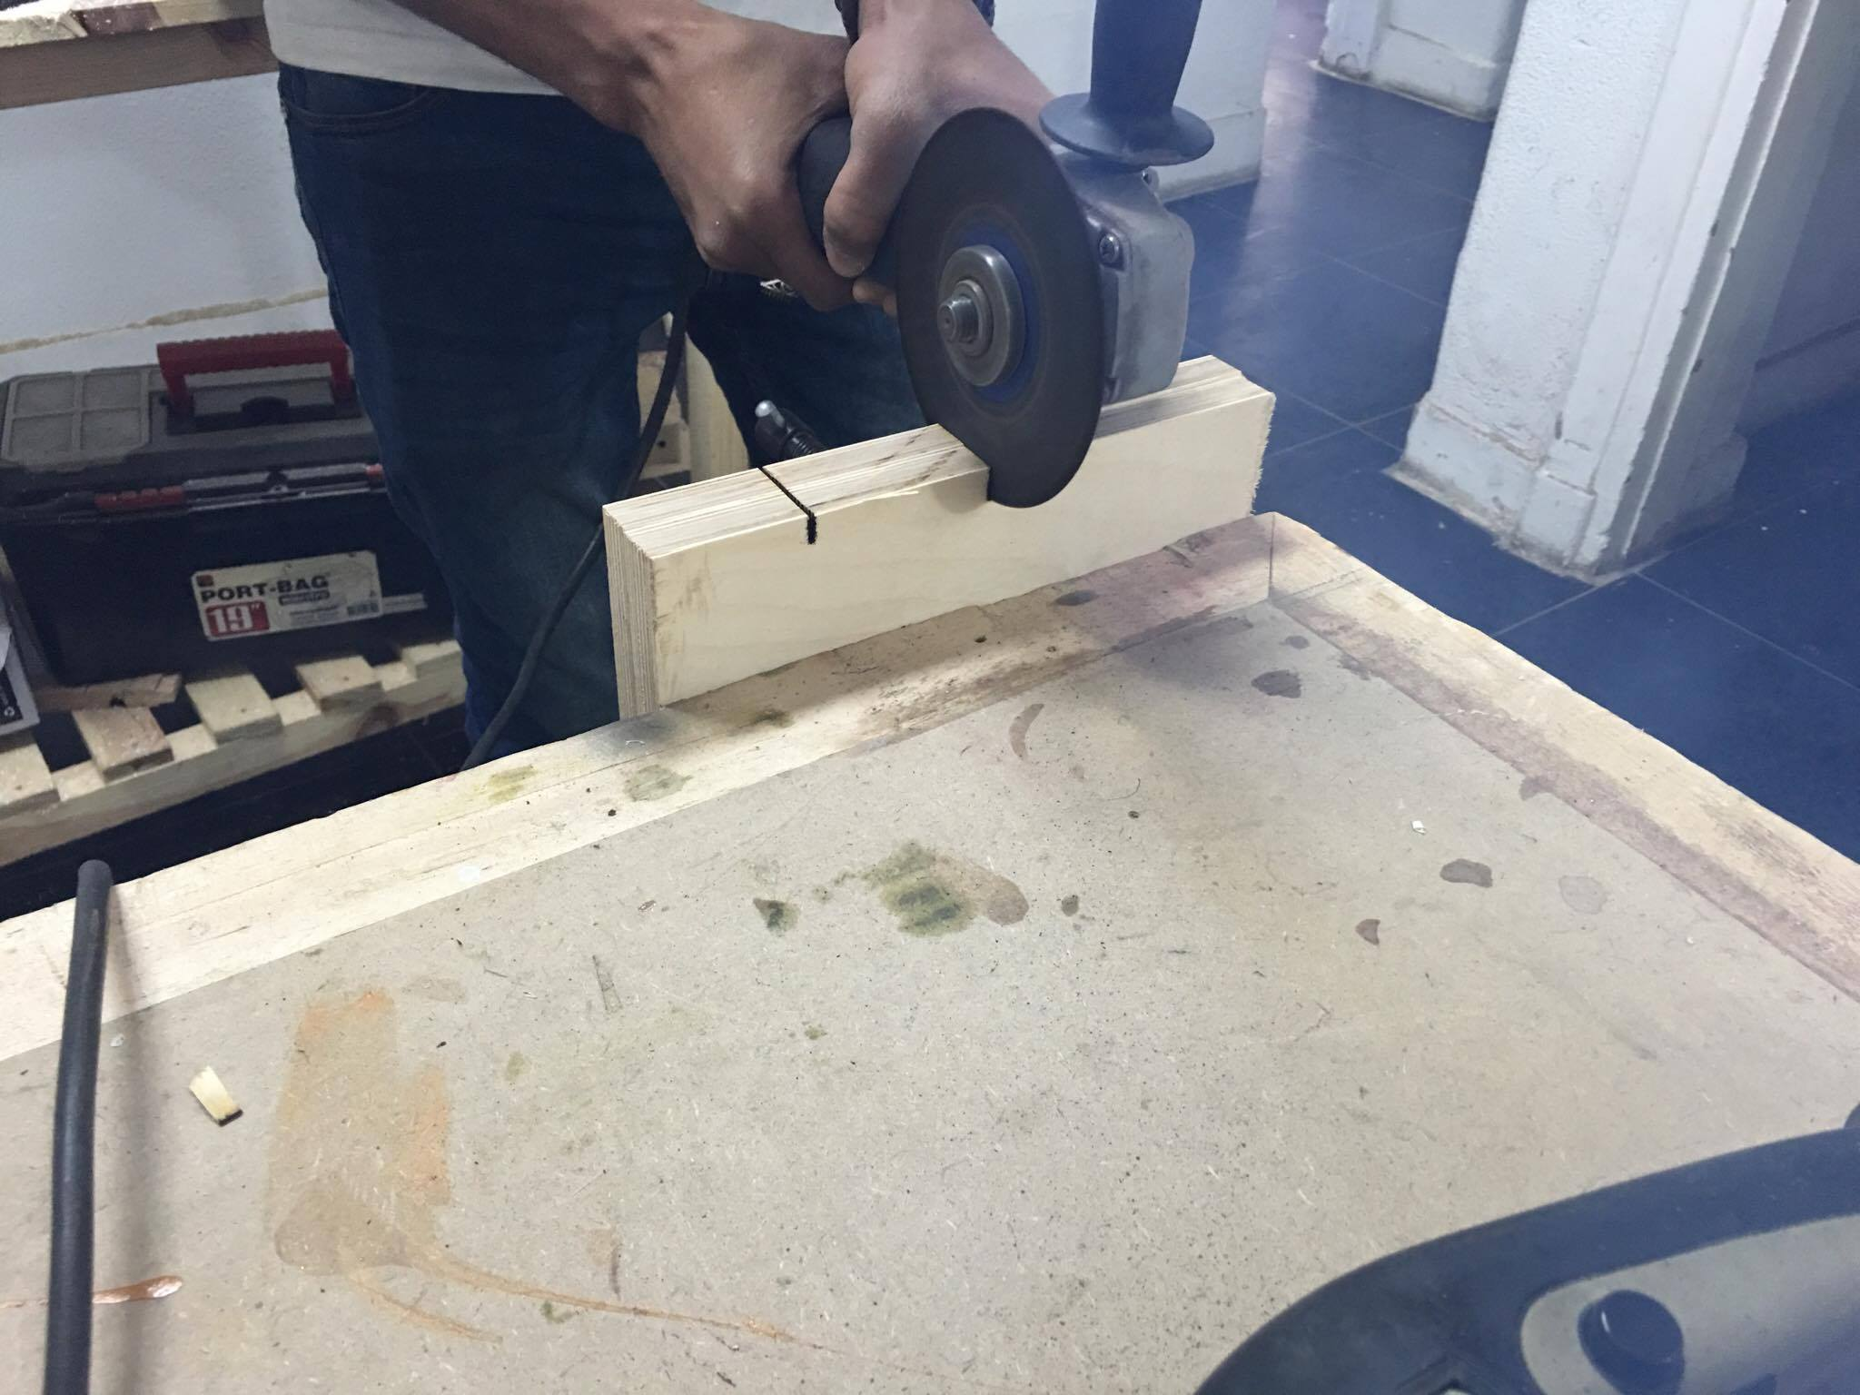

Slide 64
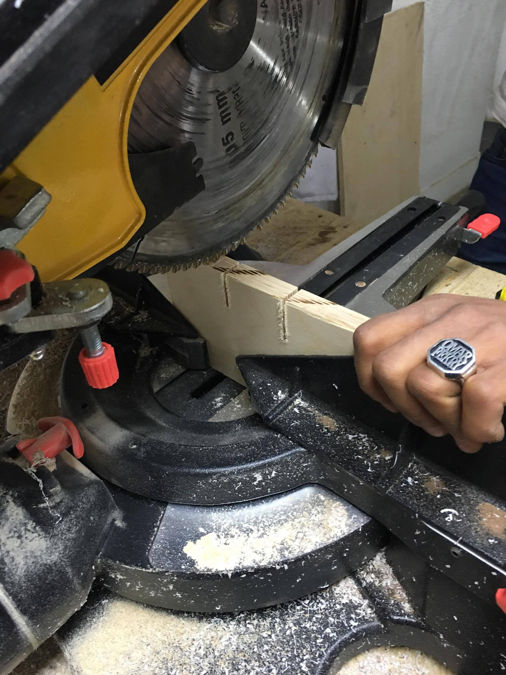

Slide 65
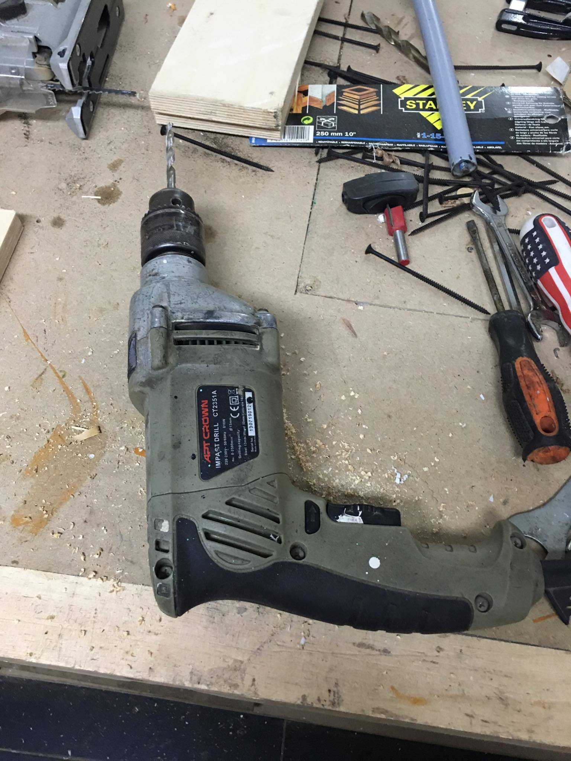

Slide 66
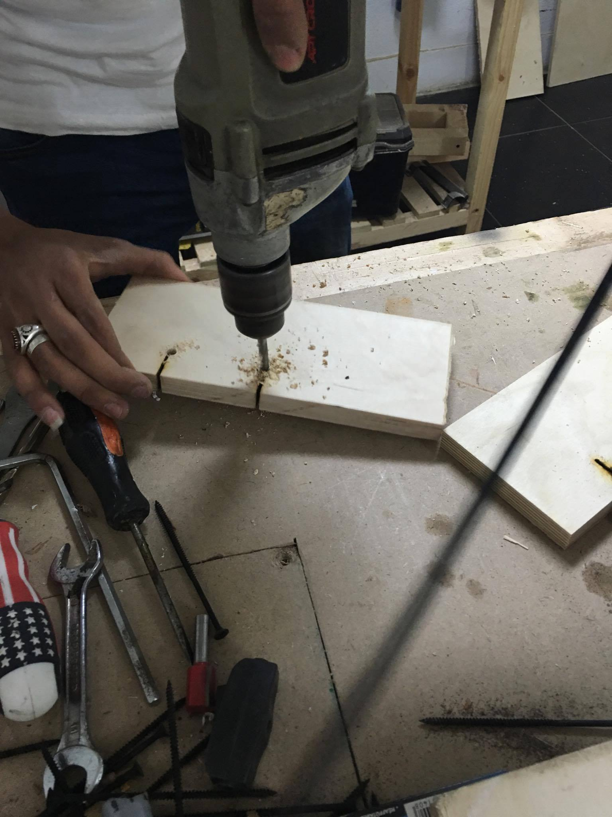

Slide 67
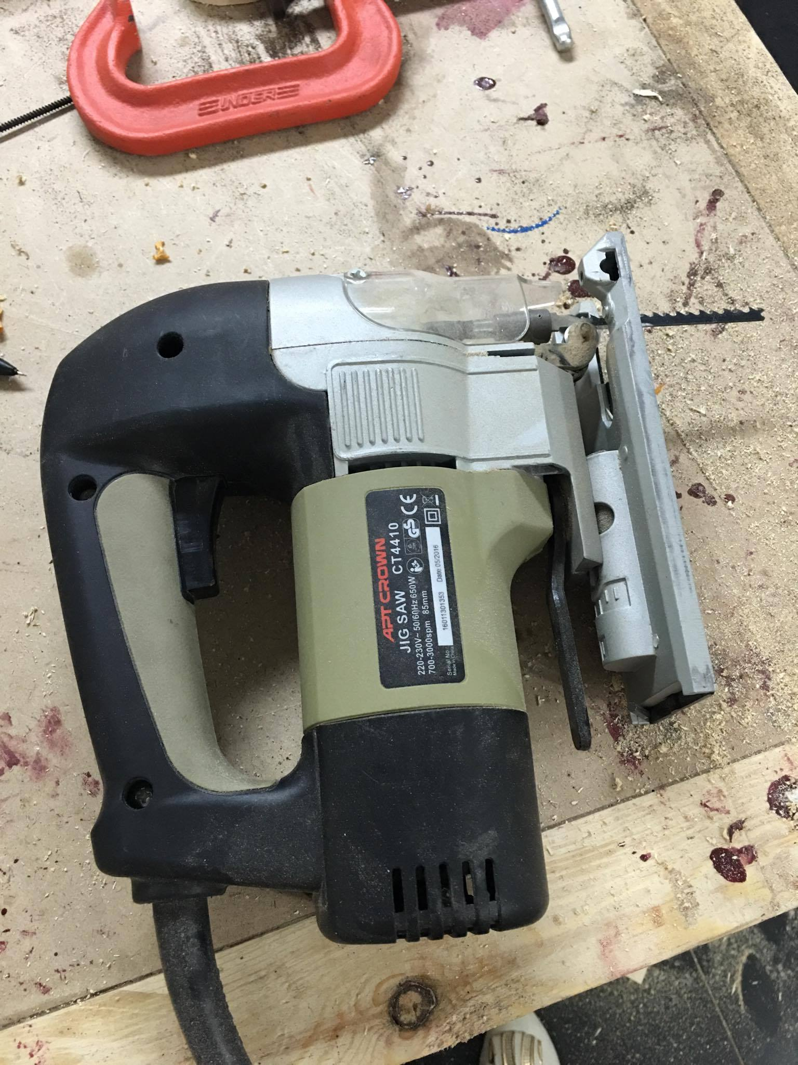

Slide 68
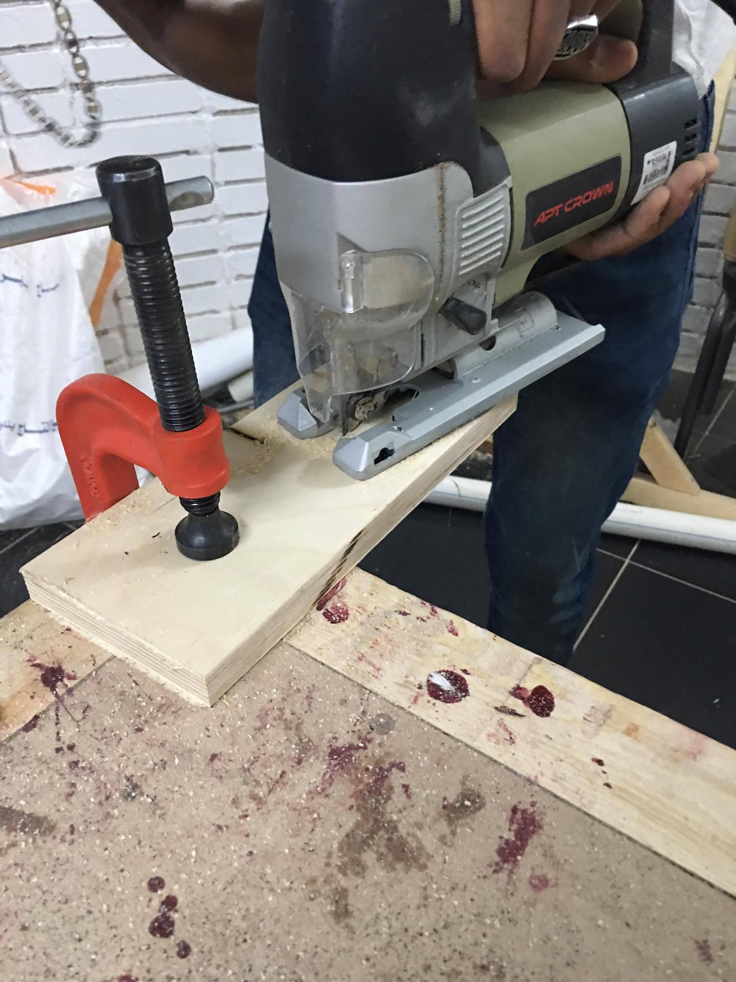

Slide 69
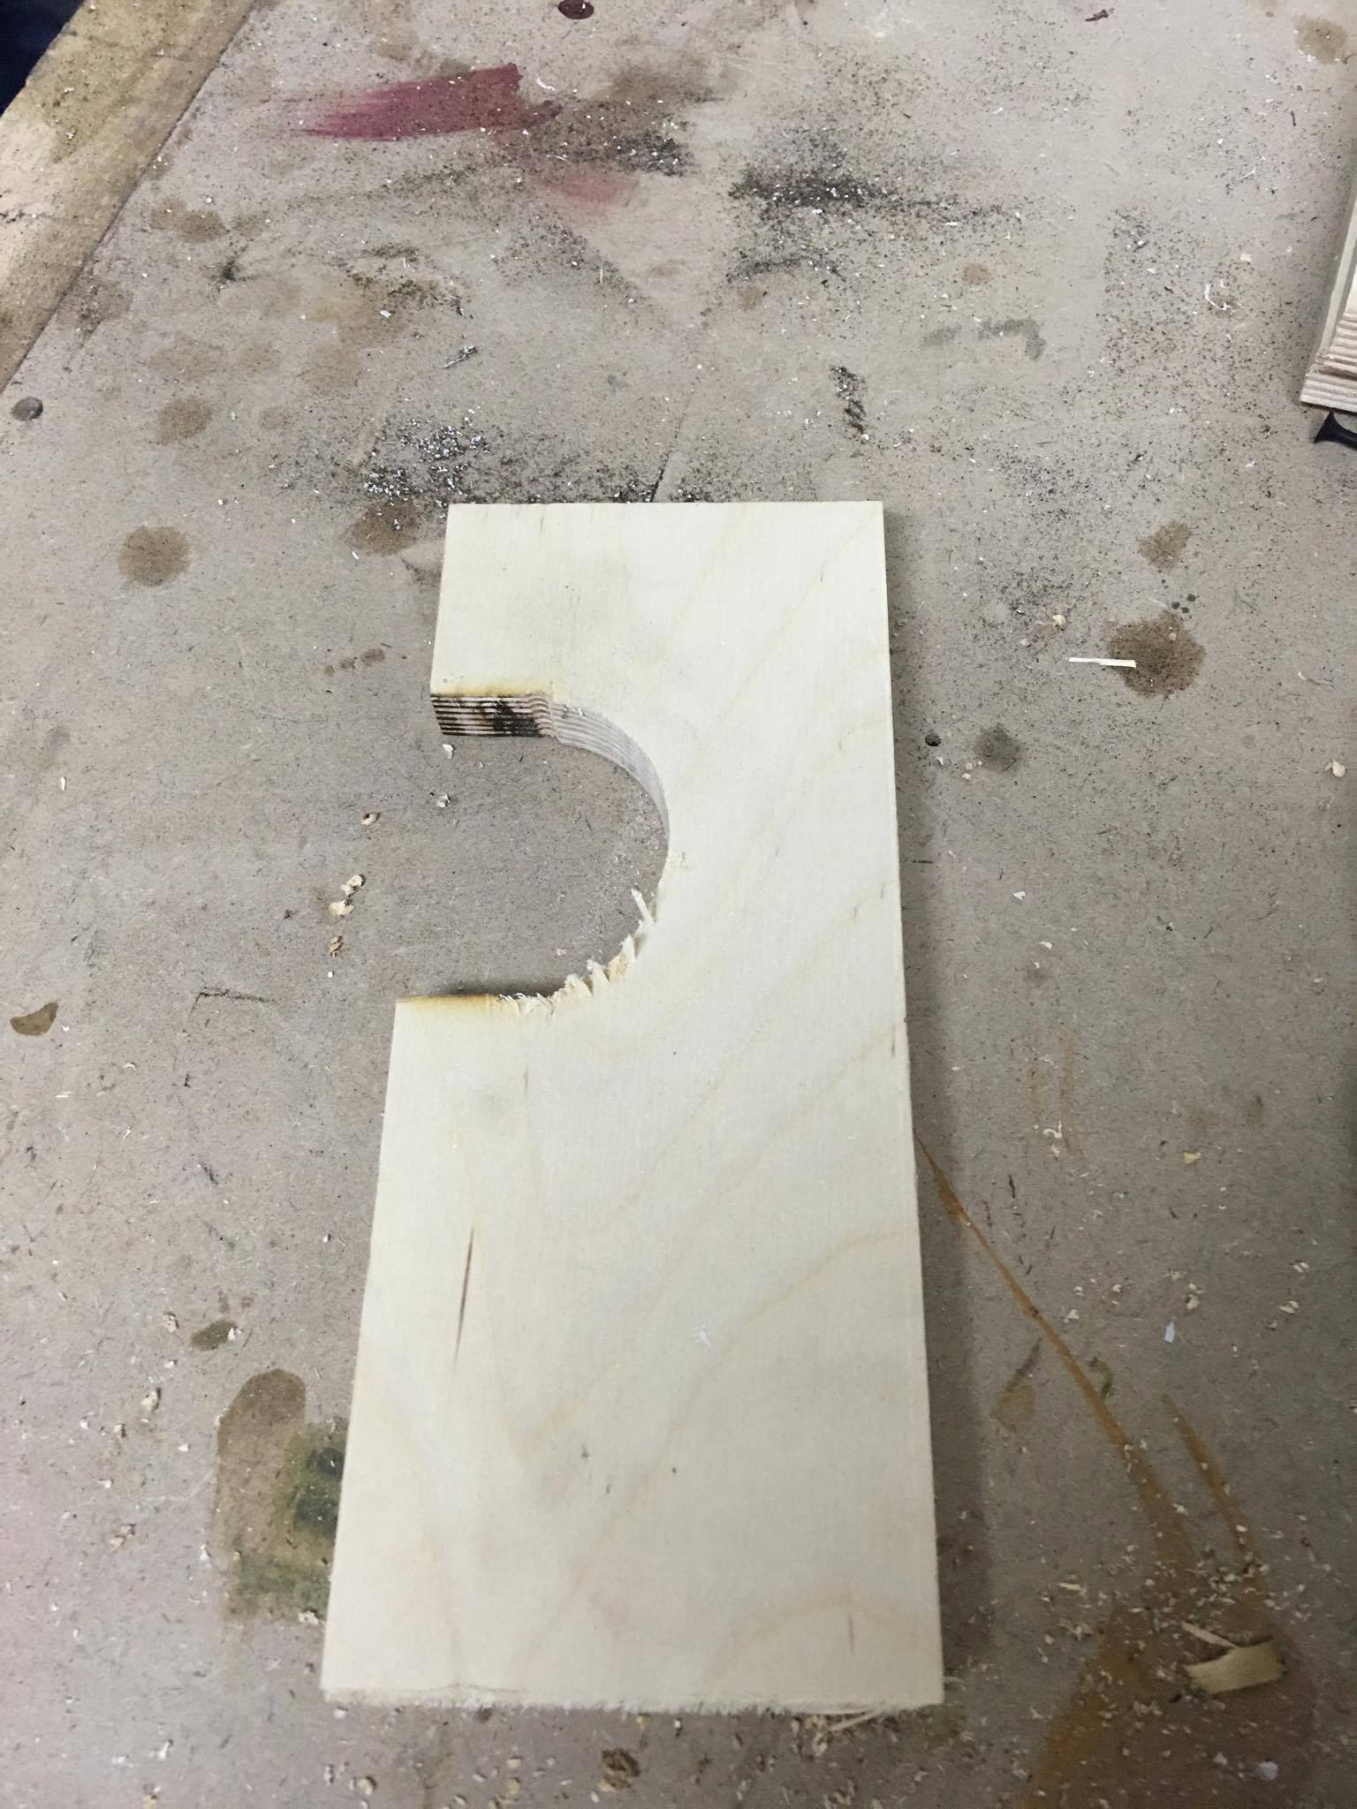

Slide 70
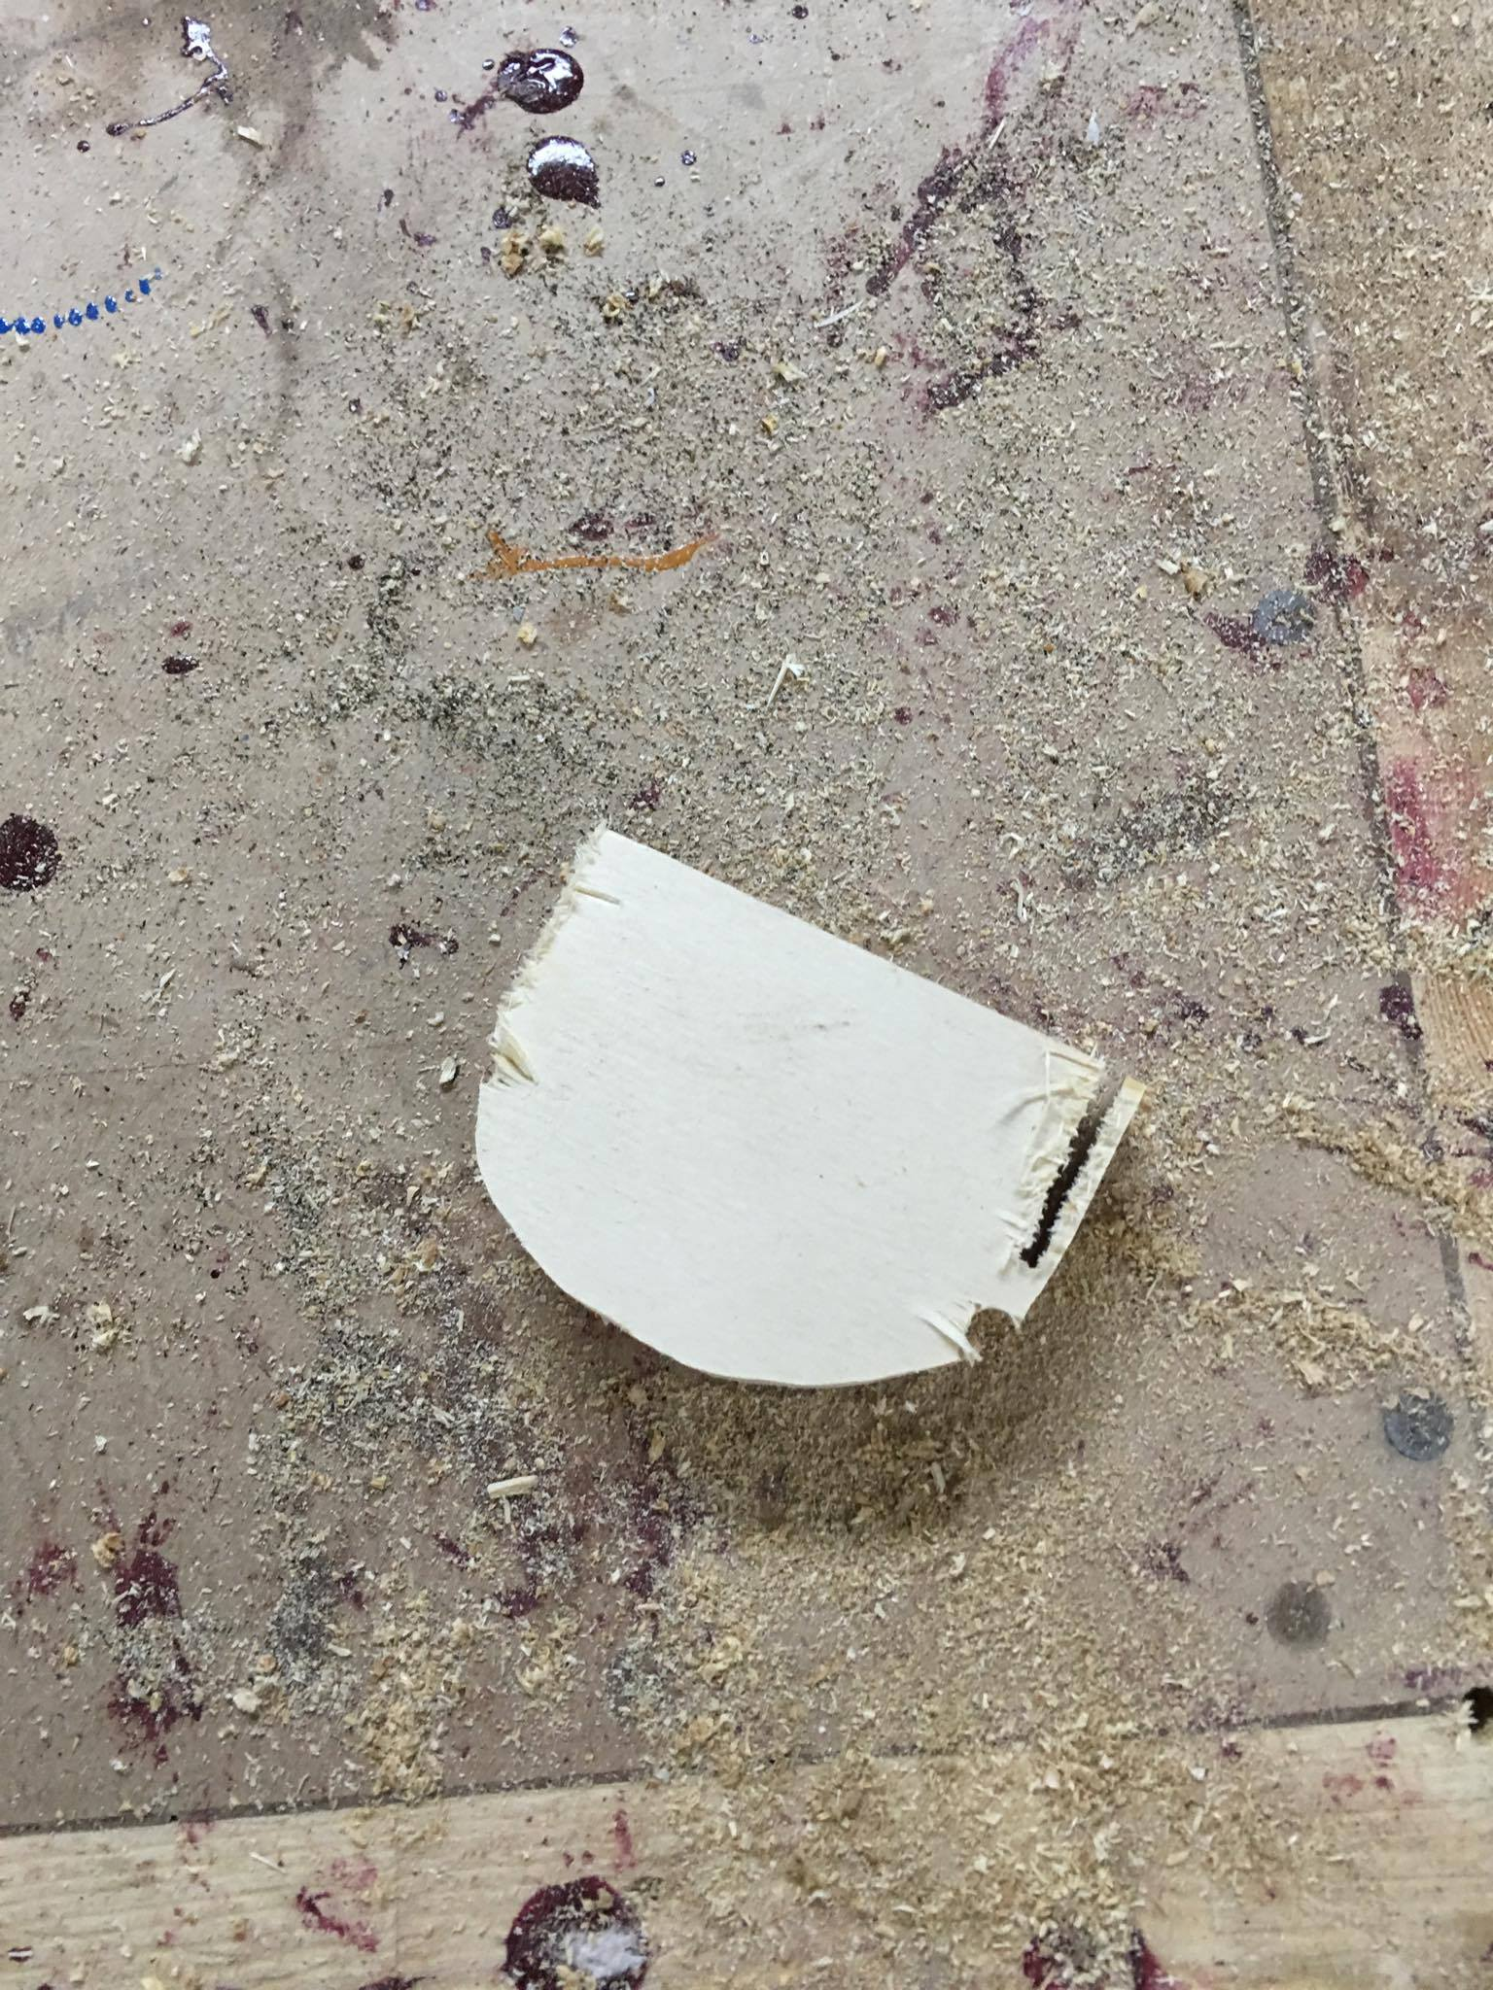

Slide 71
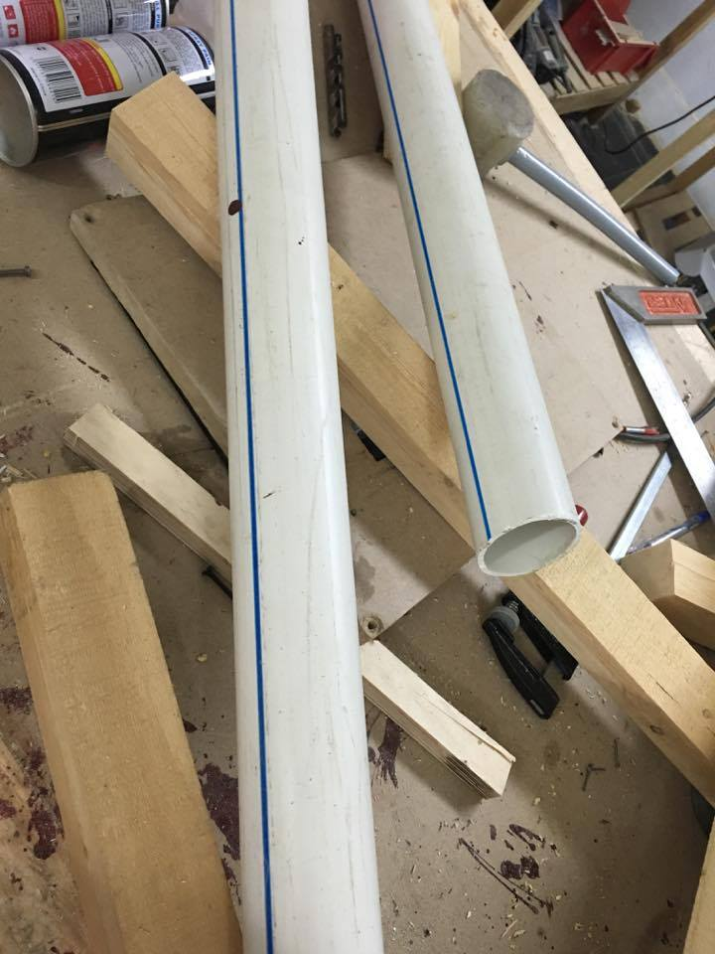

Slide 72
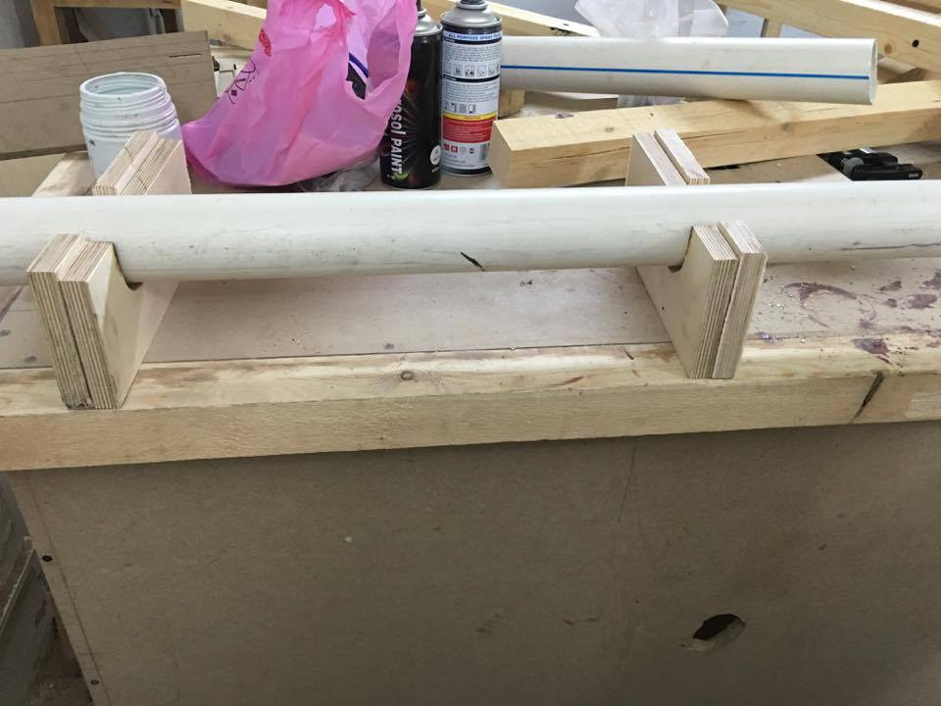

Slide 73
Prototype budget
component | place | price
keypad | Future electronics | 25 EL
Servo motor | -- | 60EL
PCB | MTM | 7EL
IC | Future electonics | 40EL
9v battery |  | 7
Tube |  | 13EL

Slide 74
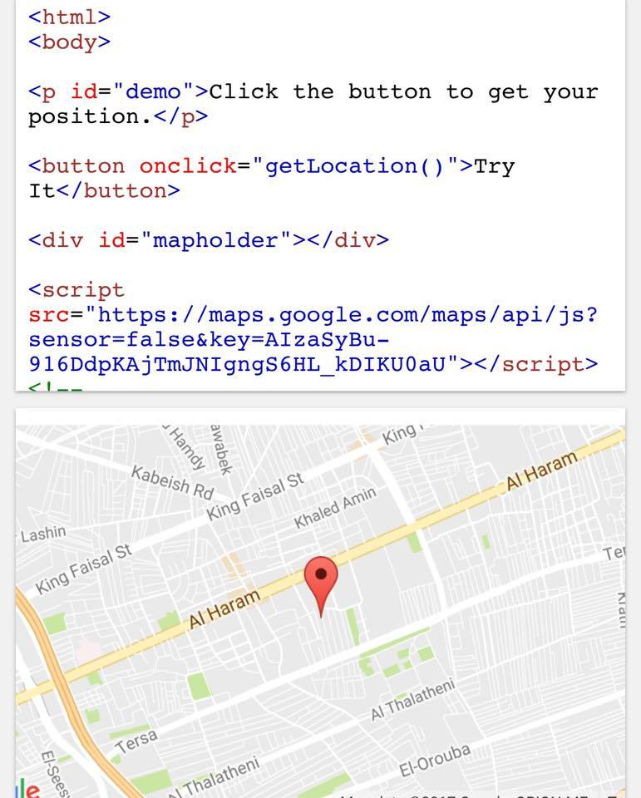
site

Slide 75
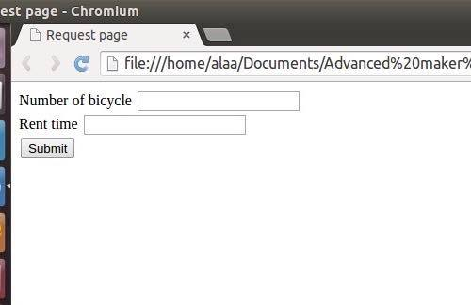
site

Slide 76

Back end

Slide 77
What next?
Product
Front End
Business model
prototype
Back End
Business Plan
First unit

